Slide 1
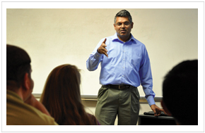
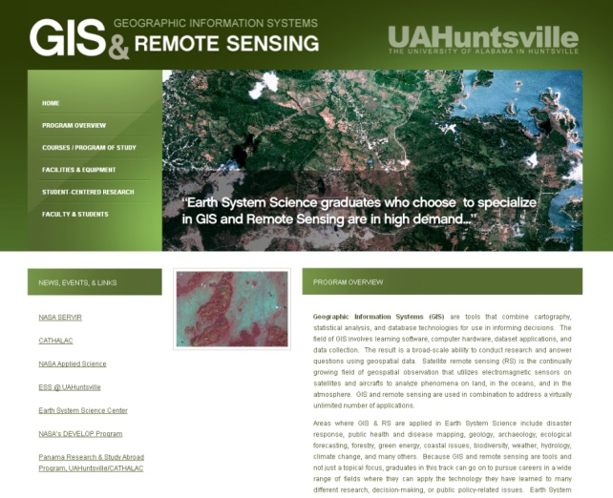
Geospatial (GIS&RS) Education/Training
1) BS in Earth System Science
Focus in Remote Sensing and GIS
2) MS in Earth System Science
3) JUMP Program
Joint Undergraduate –Masters Program
4) Study Abroad Program
Applied research focus and developing solutions for transitioning data and analyses to end-users/decision-makers, Work with external organizations, Internships/Co-Ops with private and government organizations to provide real-world training
http://nsstc.uah.edu/ess/GIS/
http://nsstc.uah.edu/ess/ESS/
http://nsstc.uah.edu/panama/

Slide 2
GIS & Remote Sensing in Earth System Science (BS/MS)
1) Atmospheric Science
2) Atmospheric Chemistry
3) GIS & Remote Sensing
4) Earth Ecosystems
5) Hydrology
6) Human Dimensions/Impacts
Declared ESS Majors (UG)
2013: 90+
ESS MS Students
2013: 7
ESS 499
ESS 413
ESS 411
ESS 370
ESS 414
ESS 415
JUMP
ESS 418
2008
2009
2010
2011
2012
2013
ATS 670
ESS 514
ESS 513
ESS 590
ESS 610
Current Geospatial Courses:
ESS 370: Introduction to Satellite Remote Sensing
ESS 411: Introduction to GIS (CE)
ESS 413/513: GIS and Image Processing
ESS 414/514: Geospatial Applications
ESS 415/515: Advanced GIS
ESS 499: Undergraduate Research Capstone
ATS 670: Satellite Remote Sensing I
ATS 680: Numerical Modeling Applications for ESS
ESS 515
ESS 612
Future (2013) Course Additions:
ESS 418: People and Pixels: Linking Remote Sensing and Social Science
ESS 610: Land Use Applications and Sustainability
ESS 612: Advanced GIS for Earth Atmosphere Problems

Slide 3
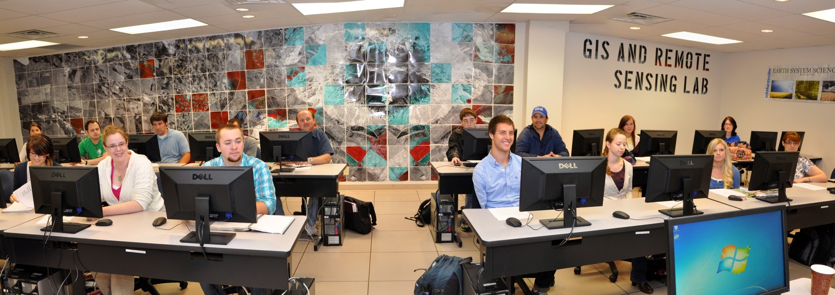
GIS/RS Research Computing Facilities @ NSSTC
available UG/GR student facilities to conduct research, interact with peers and mentors, and “own” their research
NSSTC (Bud Cramer Hall @ UAHuntsville Campus)
29 Dell Optiplex workstations
ArcInfo 10.1 (Spatial, 3D, Network, Geostatistical)
ENVI 5.0 +IDL
Mobile ESS Lab (Dell ATG semi-rugged laptops, full GIS/IP software, Garmin handheld GPS)
used in the field in Mexico, Panama, Guatemala, Atlanta, Tennessee, Alabama
GIS & Remote Sensing Lab (NSSTC 4085)

Slide 4
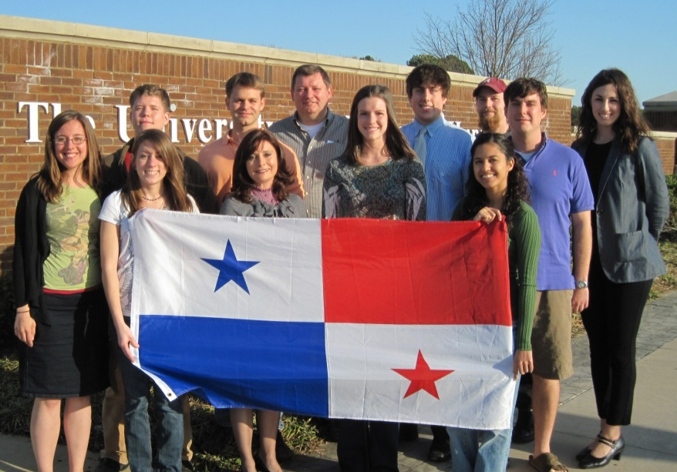
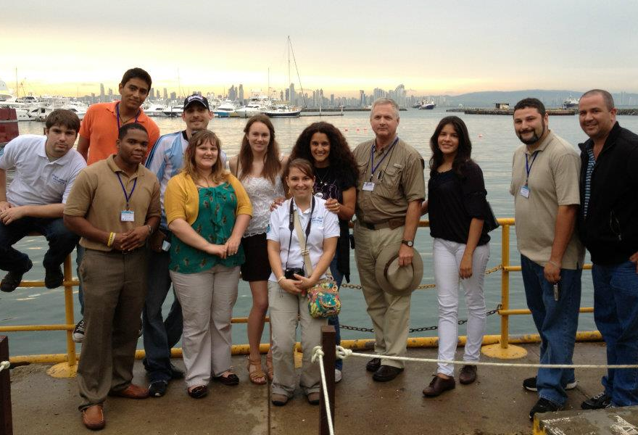
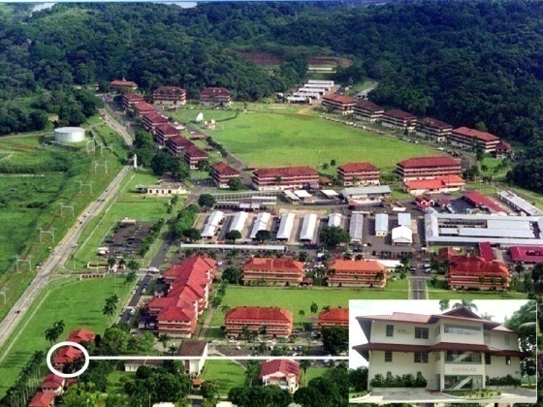
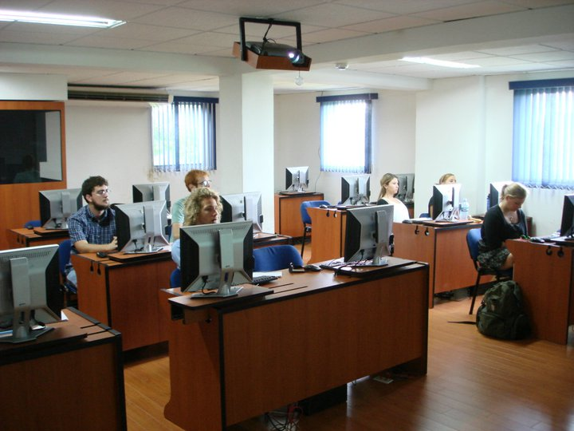
Study Abroad Research Opportunities: Panama
Climate Change & Sustainability in Latin American and the Caribbean
2010
2011
2012
Spanish instruction at Florida State, Panama & Cultural immersion in home stays in Panama
Technology (GIS/Image Processing) & Policy and Science (climate change/sustainability) instruction
CATHALAC and UAHuntsville scientists and faculty

Slide 5
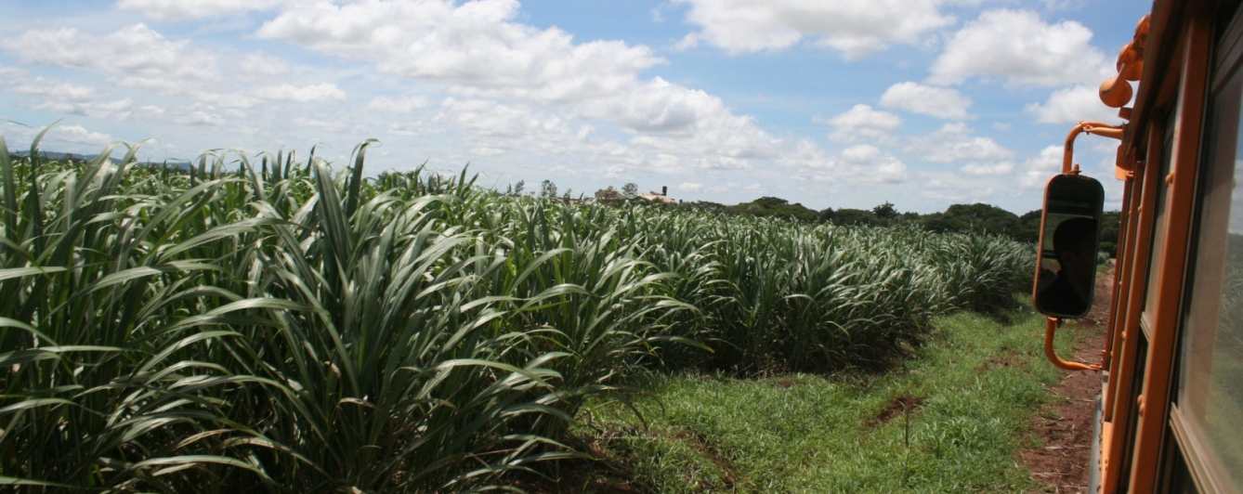
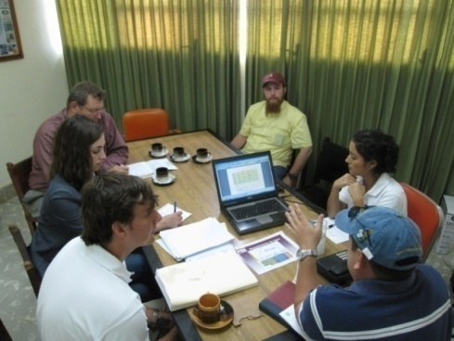
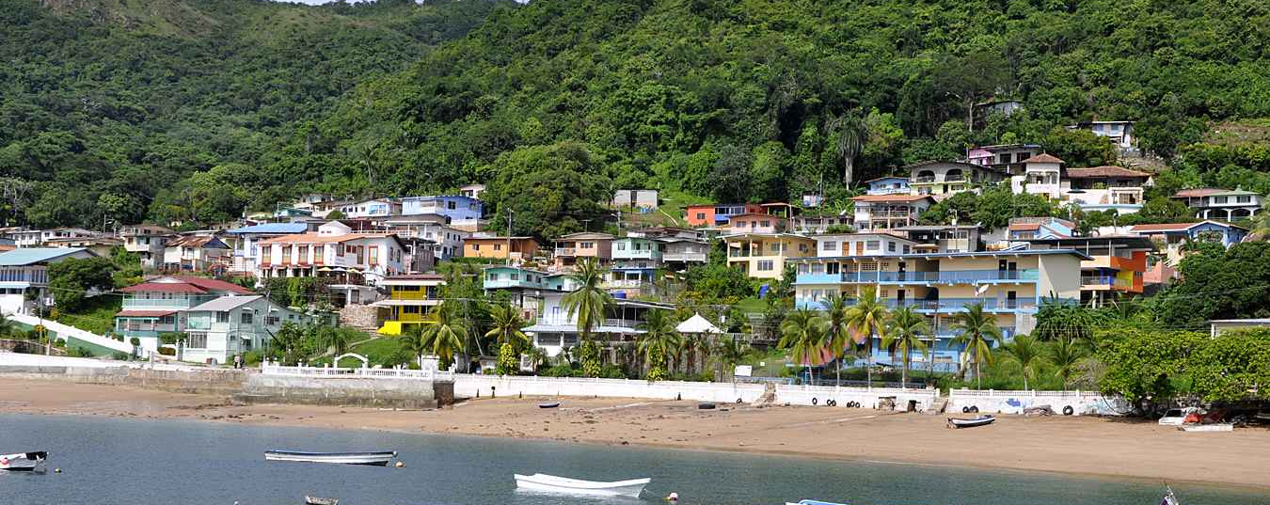
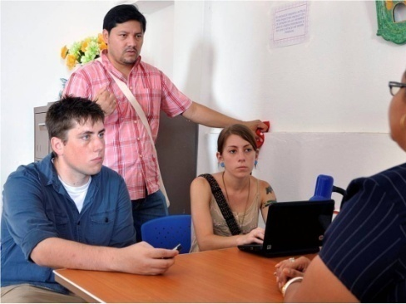
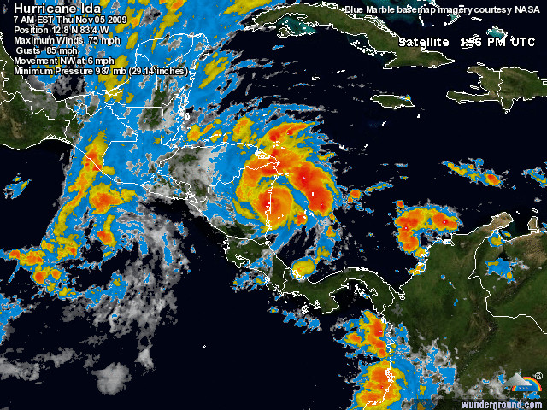
Study Abroad Research: Panama
2011/2012 Research Projects
Evaluation of Precipitation, Temperature, and Soil Condition effects on Sugar Production at Ingenio Santa Rosa, Panama using Remote Sensing Data (Kirsten Cooksey, David McConnell, Joshua Smith)
Projections on Potential Impacts of Changing Precipitation and Land Cover on Sedimentation in the Panama Canal Watershed (Tiffany Keeton, Cory Manberg, Josh Myrick)
Developing the Hydrological Problematique of Taboga Island (Amanda Bosserman, Jason Pounders)
Nitrogen fixing Fabaceous plants and their benefits to agriculture (Joseph Wayman)
Los Emberá y sus Recursos: la Vulnerabilidad de los Recursos Naturales al Cambio Climático (Claire Herdy, Emma Norton, Nancy Pospelov)
Comparison of MM5 and WRF Forecast Models, CMORPH and Hydro Estimator Satellite Estimates to Ground-Based Rain Gauge Data (Nicole Dsouza, Melanie Phillips)

Slide 6
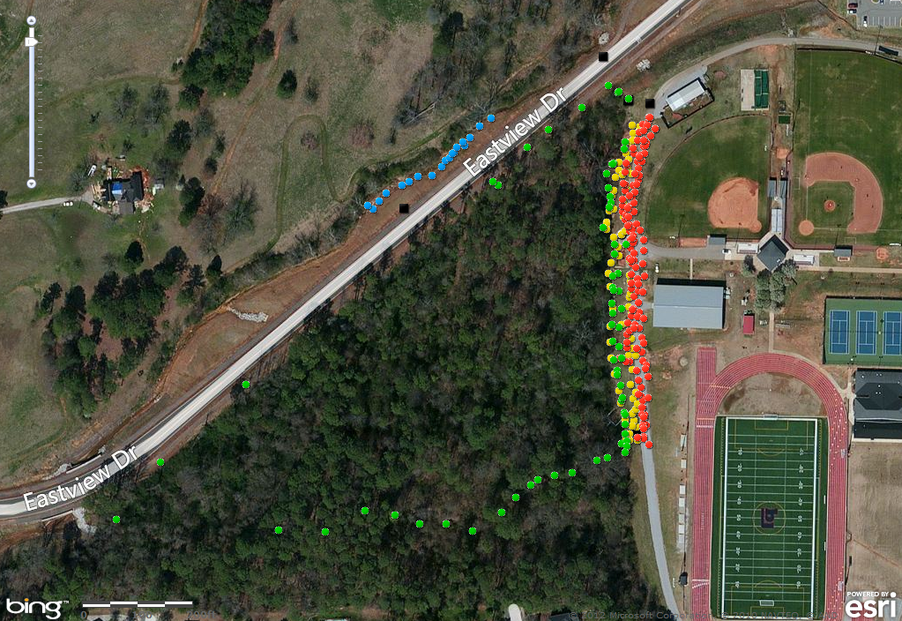
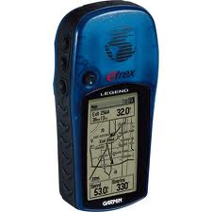
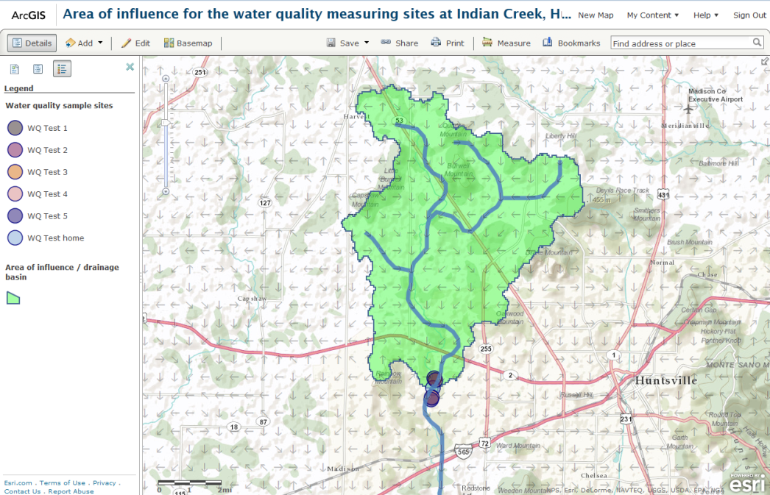
Geographic Information Systems in Advanced Placement Environmental Science (GIS in APES)
Community and high school outreach via directed STEM teaching by MS graduate students in Earth System Science (ESS 490ST) and Civil Engineering.
GIS as a tool for water resources/pollution issues at home and abroad
The many applications of GIS and remote sensing
Putting hydrology concepts into practice with geospatial data
Integrated GIS (field & lab) tie directly into APES learning goals and labs
Hands-on introduction to GIS using ArcGIS Explorer
Mark water quality testing sites using Garmin GPS
Advanced junior and senior level high school students
Eric R. Anderson
M.S. Candidate, Earth System Science
UAHuntsville
Ben Johnston
AP Envi. Sci., Bob Jones HS, Madison
Notes:
tory (victoria florence) – former apes student, still @ bob jones – now working with develop program

Slide 7
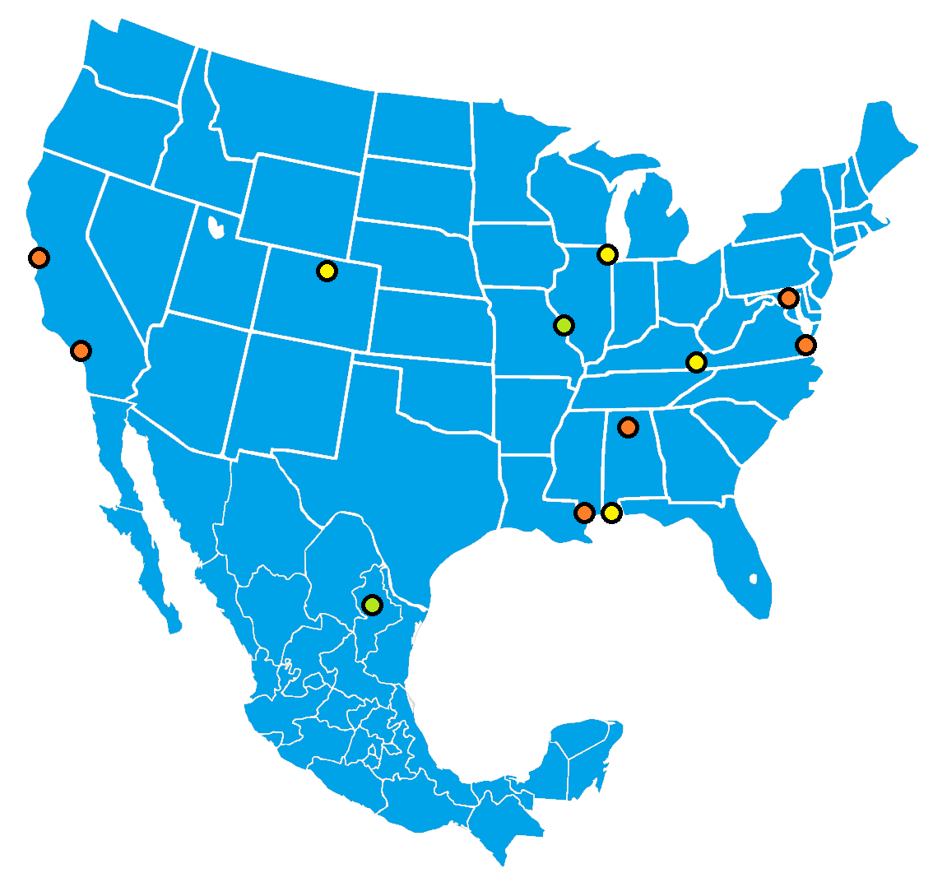
NASA-DEVELOP Research Internships (available every semester)
DEVELOP is a training and development internship enabling students and young professionals to learn about Earth science and develop prototype applications. DEVELOP addresses needs for long-term capabilities within the workforce to use Earth science results in decision making. Advisors from NASA and partner organizations assist students in using NASA data in fields such as: Agriculture, Climate, Disasters, Ecological Forecasting, Energy, Health & Air Quality, Oceans, Water Resources, Weather.
MSFC-DEVELOP Team, SERVIR Student Research Lab
Steve Padgett-Vasquez, Center Lead
University of Georgia (FNR)
Claire Herdy, Co-Lead
University of Alabama in Huntsville (ESS)
Jeff Luvall, NASA-MSFC Science Advisor
Rob Griffin, UAH-ESS Project Advisor
Marshall Space Flight Center
Alabama
NSSTC-UAH
http://develop.larc.nasa.gov/

Slide 8
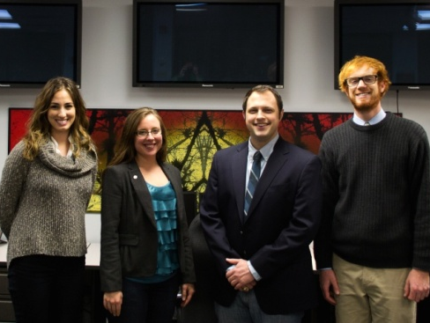
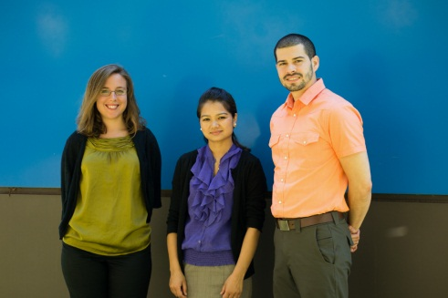
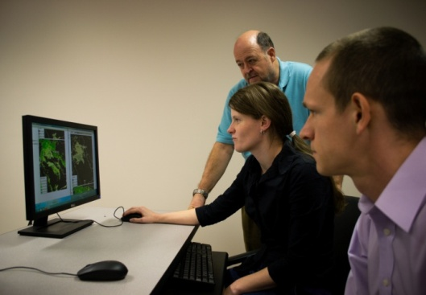
NASA-DEVELOP Research Internships
2011/2012 MSFC Projects Highlights
Leveraging NASA EOS to explore the environmental and economic impact of the April 27 Tornado outbreak in Alabama
Mobile Bay Oyster Reef Habitat Analysis, Development of a Habitat Suitability Model for Mobile Bay Oyster Reefs Based on Hydrologic Models
Using NASA EOS to Identify and Monitor Pathogenic Dust in the Middle East
Colombia Fire Forecasting: Utilizing NASA EOS data for fire management in el Departamento del Valle del Cauca,Colombia
Nepal-Food Security: Utilizing NASA’s EOS data to research the potential effects of climate change on food security in Nepal
Middle East Public Health & Air Quality:
Using NASA EOS to Identify and Monitor Pathogenic Dust in the Middle East
Southeast Ecological Forecasting: Using NASA Earth Observation (EOS) satellites for large-scale mapping of the longleaf pine (Pinus palustris) forest ecosystem.
Notes:
16 students for summer 2012, UAH 8/9 Students, 5 projects
Results accepted at IAC, AGU-DC conferences

Slide 9
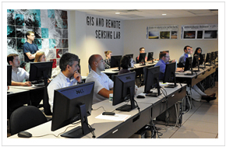
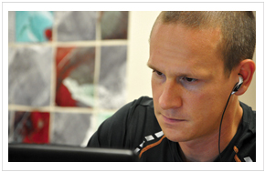
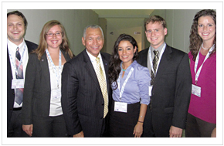
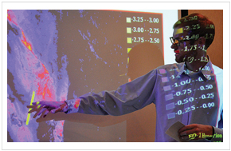
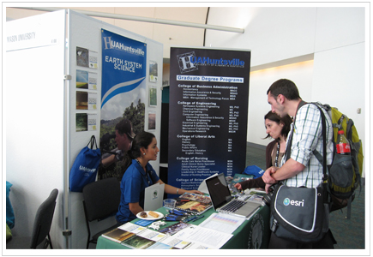
Student Research/Training Involvement & Successes
Student-Led Training Events
Hyperspectral Image Analysis
Workshop (Africa Flores)
Student Research Presentations
DEVELOP Internship Final
Results Presentations (Kevin Cowart,
Brad Barrick)
Conferences Student Participation
& Outreach
IAC 2012, ESRI 2012/2013
Notes:
Student Successes:
Posters & Papers Presented:
American Astronautical Society (AAS) Annual Werner von Braun Symposium
International Astronautical Congress, 2011 – 3 student papers
International Astronautical Congress, 2012 – 8 student papers, 6 participants
Semester Internships: STRI Ernst Meyer, ORNL, DEVELOP, RCEU
Graduate Student Fellowships: UAH, PSU, SERVIR
Job Placement: USRA, Telcordia

