Slide 1
2010:
The Year the Geospatial Industry
Came of Age
David DiBiase, CMS, GISP
Penn State University
National Geospatial Technology Center
Rocket City Geospatial Conference
Huntsville AL
November 17, 2010
Sponsors include the National Science Foundation’s Advanced Technological Education program [DUE #0801893]. Author’s opinions are not necessarily shared by NSF.

Slide 2
“Just as nobody likes a wiseguy, nobody likes a definition.”
Davis, Michael (2002). Ethics and the University. New York: Routledge.

Slide 3
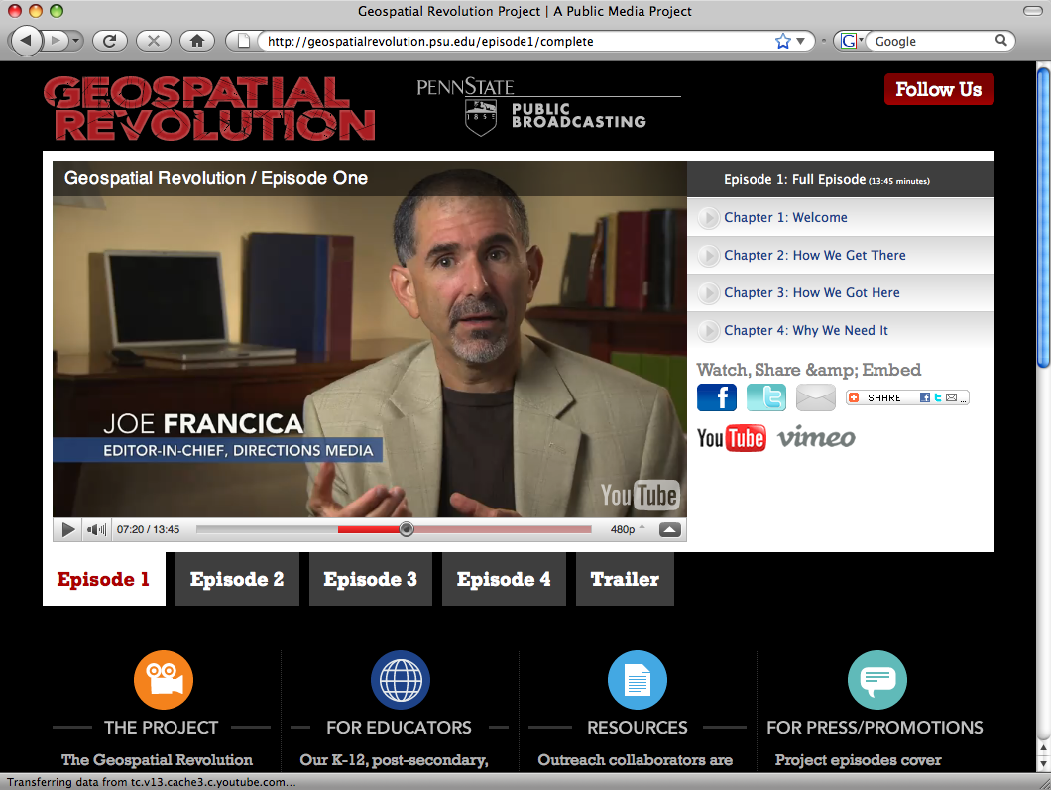

Slide 4
Two important developments at DOLETA
Six new geospatial occupations established
New Geospatial Technology Competency Model (GTCM) published

Slide 5
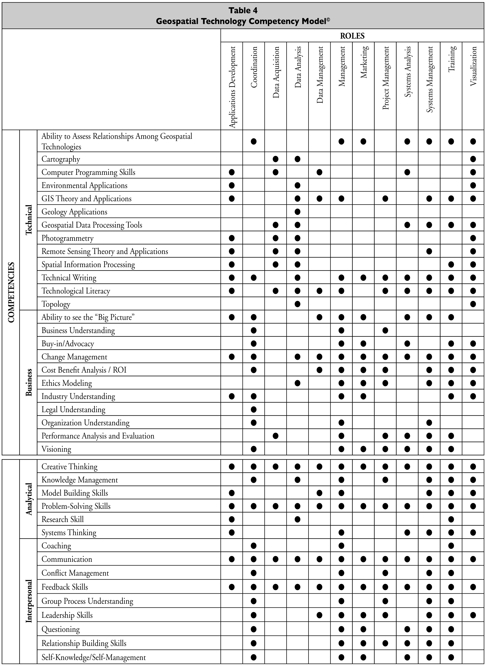
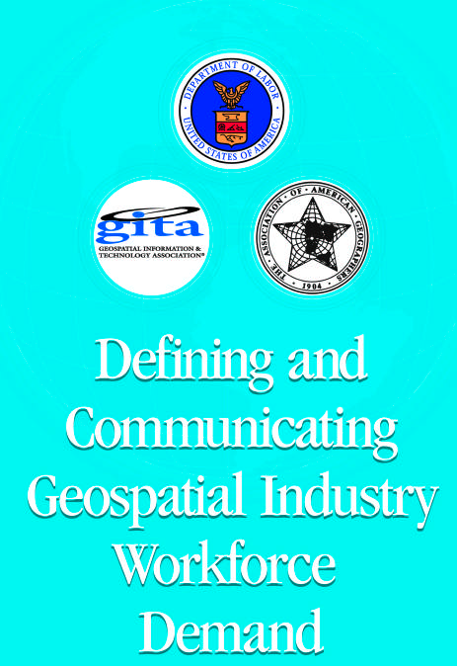
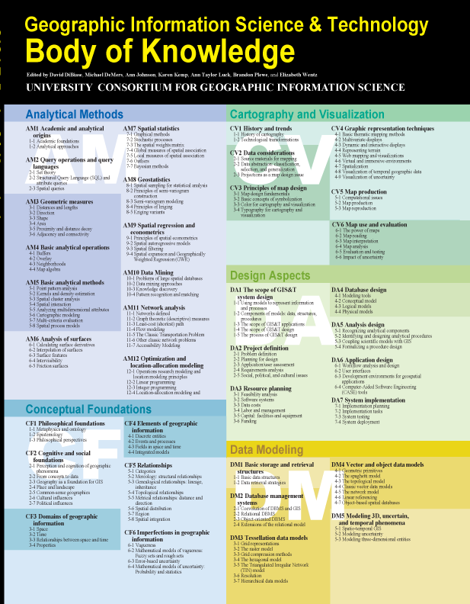
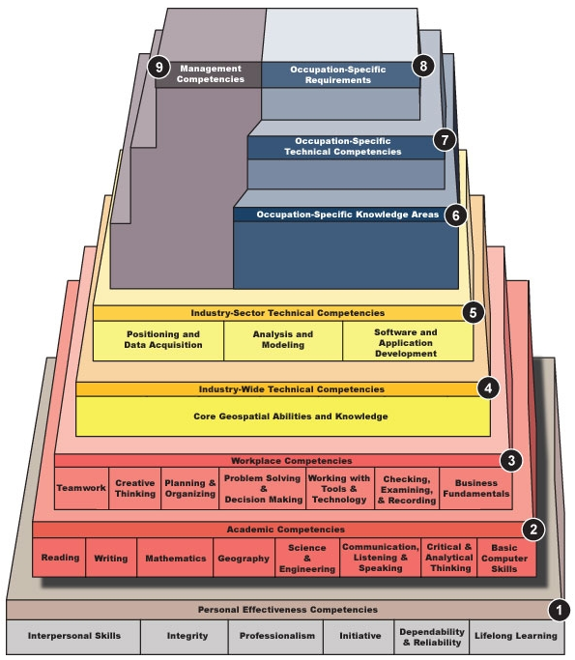
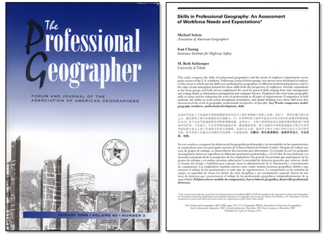
2000-2003:
Original GTCM
2005-2006: Industry
Definition Workshops
2004-2006: GIS&T
Body of Knowledge
2008: Skills in Professional Geography
2008-2010: New GTCM

Slide 6
A competency is the capability of applying or using knowledge, skills, abilities, behaviors, and personal characteristics to successfully perform critical work tasks, specific functions, or operate in a given role or position.
Ennis, M.R. (2008). Competency Models: A Review of the Literature and The Role of the Employment and Training Administration (ETA), www.careeronestop.org/competencymodel/.../OPDRLiteratureReview.pdf

Slide 7
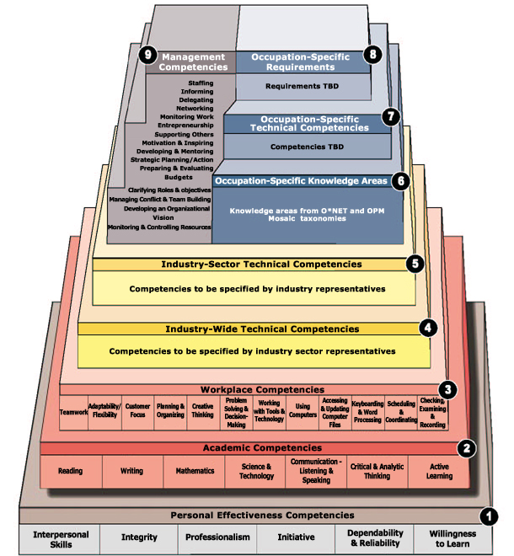
Building block model
A competency model is a descriptive tool that identifies the competencies needed to operate in a specific role with a(n) job, occupation, organization, or industry.

Slide 8
Building block model
Requirements for specialized degrees, licensure, or certification (e.g., GISCI)
Competencies required for particular occupations identified by DoL partners (e.g., GeoTech Center)
Management competencies
Knowledge areas required for particular occupations identified by workforce analysts
Competencies needed for various occupations within an industry sector
Competencies needed for various occupations within an industry
Competencies needed in many occupations and industries at national scale

Slide 9
DOLETA Competency Modeling Process
Gather background information
Develop draft competency model framework
Gather feedback from industry representatives
Refine the competency model framework
Validate the competency model framework
Finalize the model framework
PMRI, Inc. (2005). Technical Assistance Guide for Developing and Using Competency Models—One Solution for a Demand=Driven Workforce System. http://www.careeronestop.org/competencymodel/Info_Documents/TAG.pdf

Slide 10
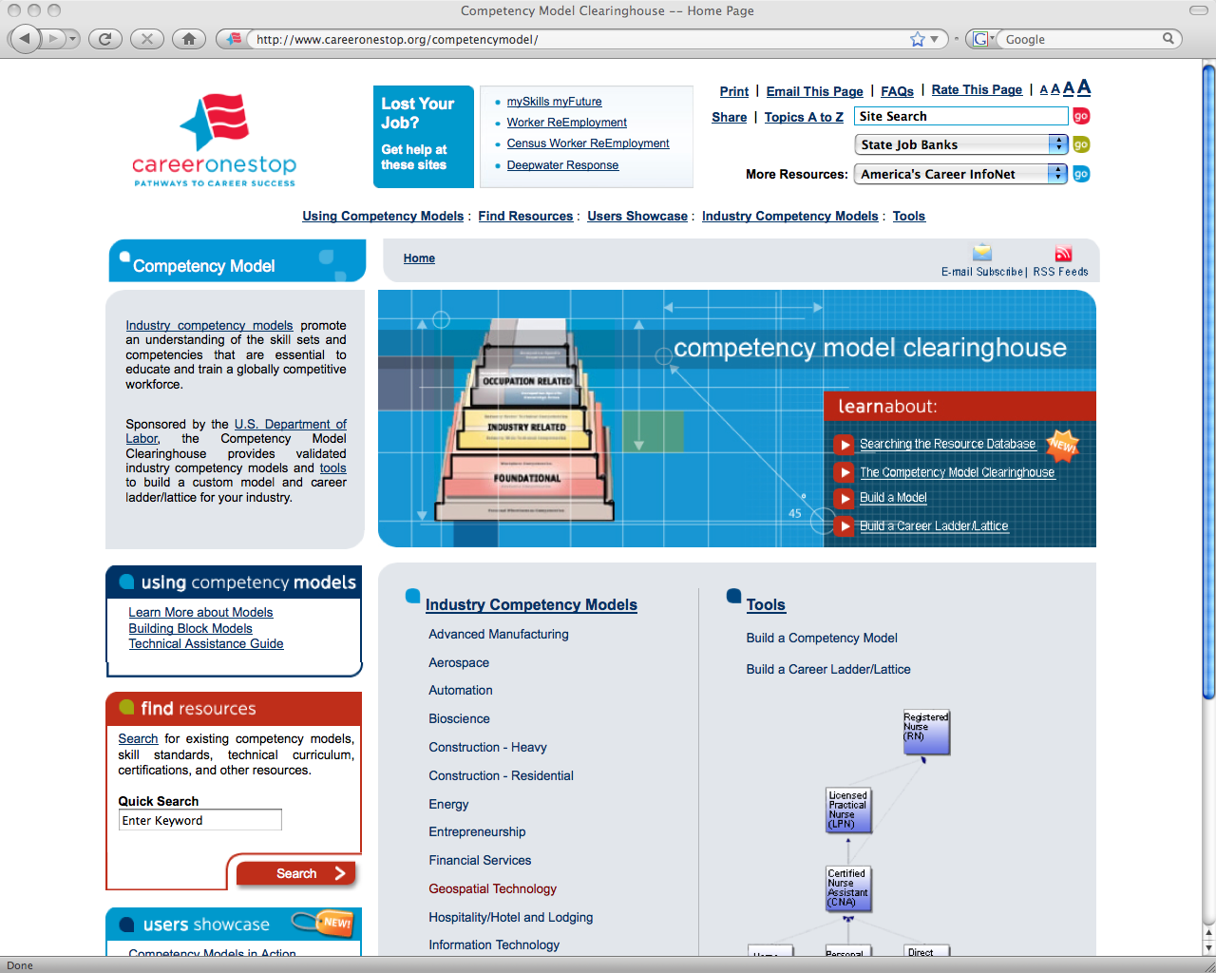

Slide 11
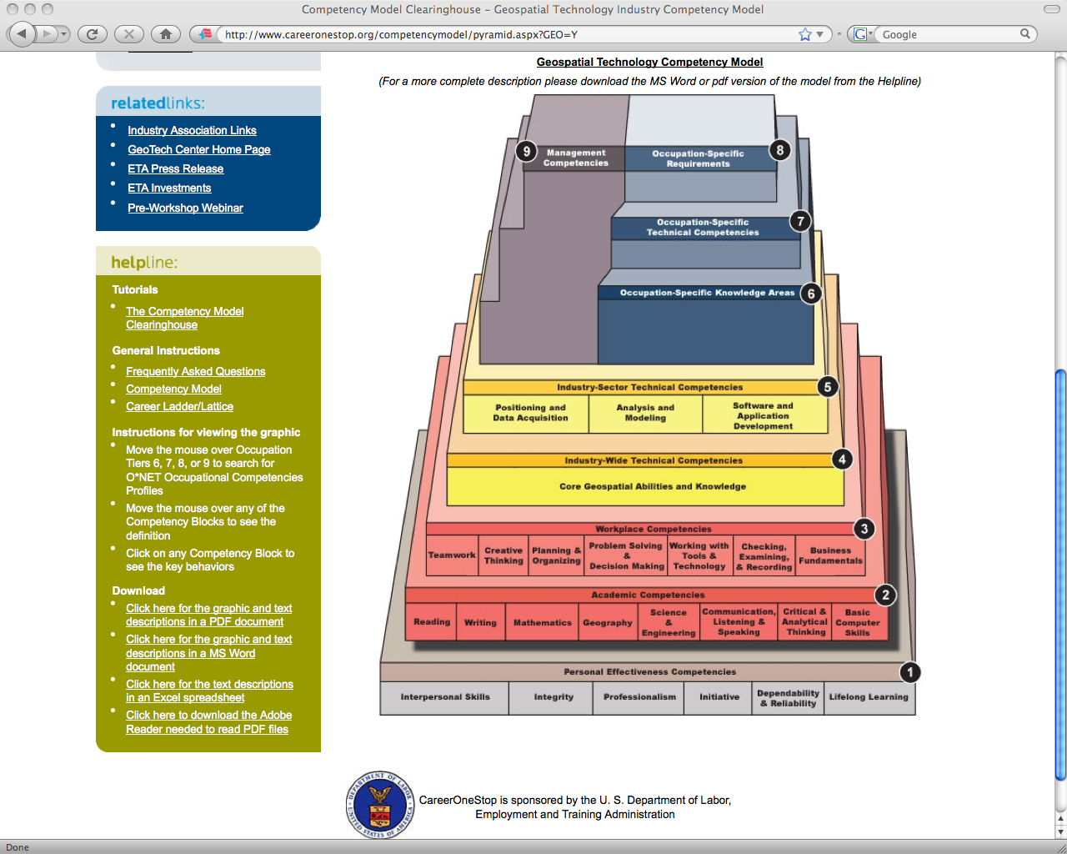

Slide 12
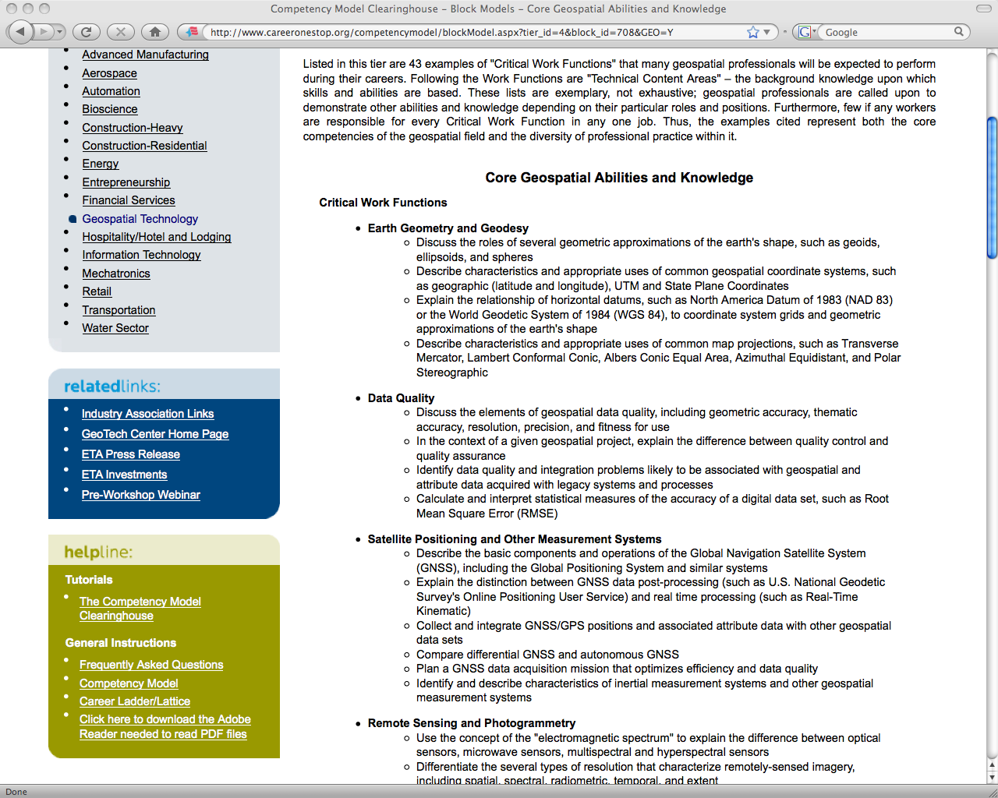

Slide 14
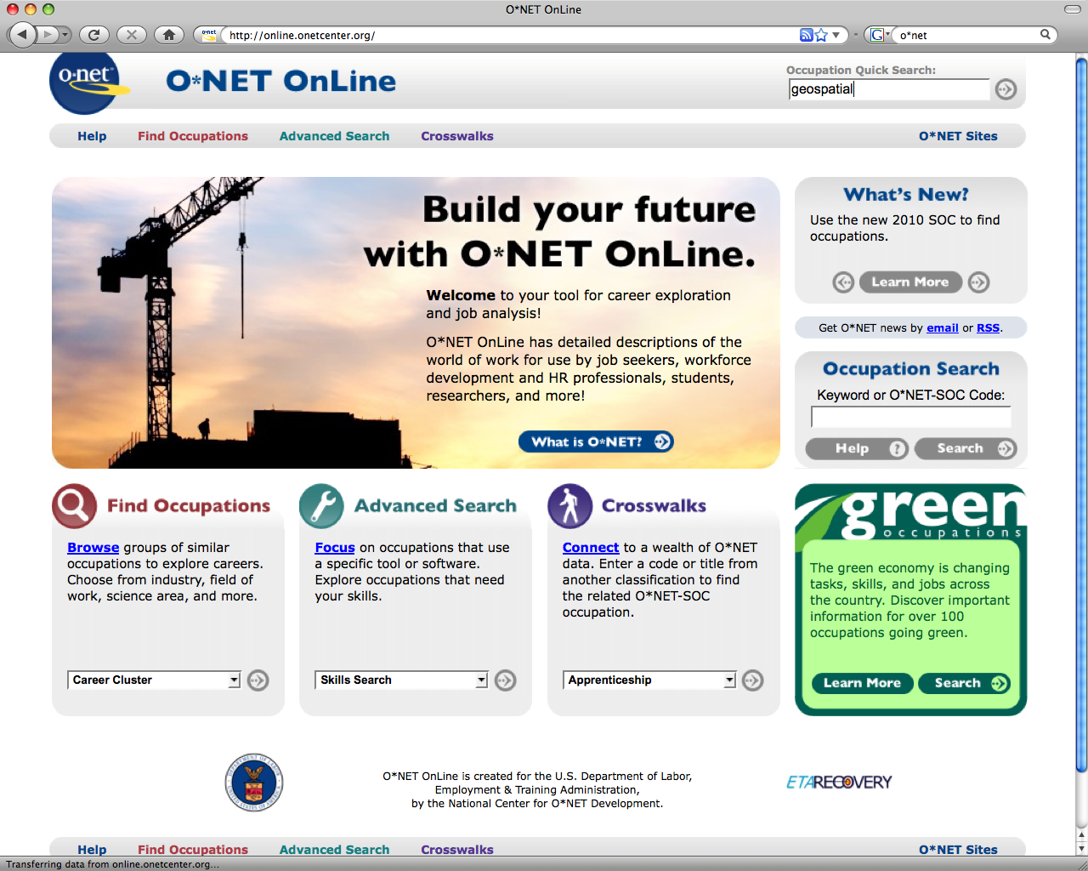

Slide 15
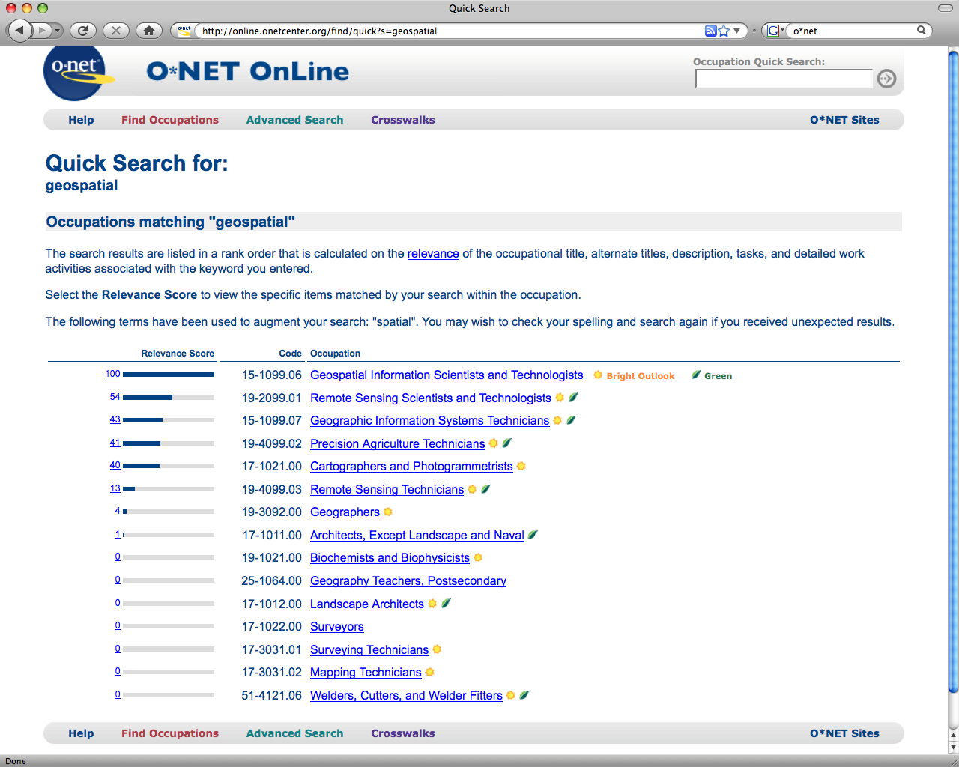

Slide 16
The geospatial occupations
Occupation | Employment (2008) | Projected Growth (2008-18) | Growth Rate (2008-18)
Geospatial Information Scientists and Technologists* | ? | ? | ?
Geographic Information Systems Technicians* | ? | ? | ?
Remote Sensing Scientists and Technologists* | ? | ? | ?
Remote Sensing Technicians* | ? | ? | ?
Precision Agriculture Technicians* | ? | ? | ?
Geodetic Surveyors* | ? | ? | ?
Surveyors | ? | ? | ?
Surveying Technicians | ? | ? | ?
Mapping Technicians | ? | ? | ?
Cartographers and Photogrammetrists | ? | ? | ?
Totals | ? | ? | ?
Department of Labor Employment and Training Administration (2010). O*Net Online.
http://online.onetcenter.org/

Slide 17
The geospatial occupations
Occupation | Employment (2008) | Projected Growth (2008-18) | Growth Rate (2008-18)
Geospatial Information Scientists and Technologists* | 209,000 | 72,600 | 7-13% (Average)
Geographic Information Systems Technicians* | 209,000 | 72,600 | 7-13%
Remote Sensing Scientists and Technologists* | 27,000 | 10,100 | 7-13%
Remote Sensing Technicians* | 65,000 | 36,400 | 7-13%
Precision Agriculture Technicians* | 65,000 | 36,400 | 7-13%
Geodetic Surveyors* | 58,000 | 23,300 | 14-19%
Surveyors | 58,000 | 23,300 | 14-19%
Surveying Technicians | 77,000 | 29,400 | ≥ 20%
Mapping Technicians | 77,000 | 29,400 | ≥ 20%
Cartographers and Photogrammetrists | 12,000 | 6,400 | ≥ 20%
Totals | 857,000 | 339,900
Department of Labor Employment and Training Administration (2010). O*Net Online.
http://online.onetcenter.org/

Slide 18
Reports of death of GIS exaggerated
“GIS is on it’s way out as a profession, but GIS will continue to be used as a tool in many other professions.”
“My advice to someone that wants to get into the GIS field is – don’t, because it’s not going to be around much longer.”
Meltz, Don (2009). GIS Is Dead–Long Live GIS. PlanIt Crafter blog http://donmeltz.com/blog/index.php/2009/10/25/gis-is-dead-long-live-gis/ Accessed November 2, 2010

Slide 19
Unfinished business
Assess alignment of geospatial education and training curricula with workforce needs
Increase rigor of certification requirements for GIS professionals
Shore-up higher education requirements for professional surveyors
Identify the “moral ideal” of the GIS profession

Slide 20
Attributes of a profession
Pugh (1989)
Ford & Gibbs (1996)
Cast of mind—self awareness
Corpus of theory and knowledge
Social ideal
Ethical standards
Formal organizations
Hall of fame
Accreditation
Certification and/or licensure
Ford, Gary and Norman E. Gibbs (1996). A Mature Profession of Software Engineering. Technical Report, Carnegie-Mellon University, January. http://www.sci.cmu.edu/pub/documents/96.reports/pdf/tr004.96.pdf
Pugh, Darrell L. (1989). Professionalism in Public Administration: Problems, Perspectives, and the Role of the ASPA. Public Administration Review 49:1, 1-8.

Slide 21
What is the GIS profession’s moral ideal?
“A profession is a number of individuals in the same occupation voluntarily organized to earn a living by openly serving a certain moral ideal in a morally-permissible way…”
Davis, Michael (1999). Profession, Code, and Ethics. Burlington VT: Ashgate, p. 3.

Slide 22
2010:
The Year the Geospatial Industry
Came of Age
David DiBiase, CMS, GISP
Penn State University
National Geospatial Technology Center
Rocket City Geospatial Conference
Huntsville AL
November 17, 2010
Sponsors include the National Science Foundation’s Advanced Technological Education program [DUE #0801893]. Author’s opinions are not necessarily shared by NSF.

Slide 23
