Slide 1
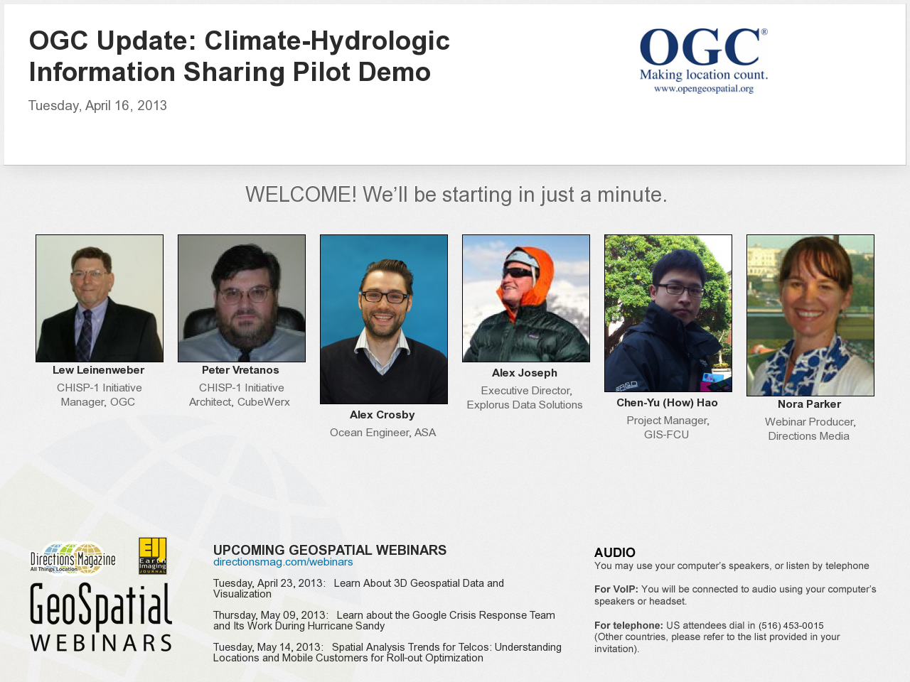
Notes:
1

Slide 2
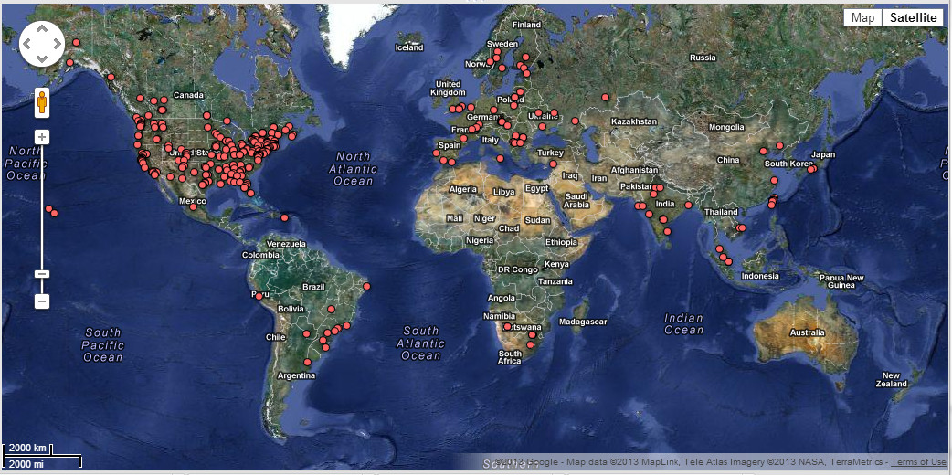
More than 450 webinar registrants from around the globe

Slide 3
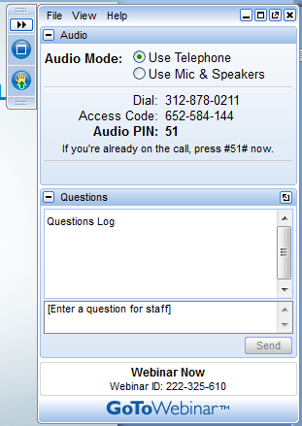
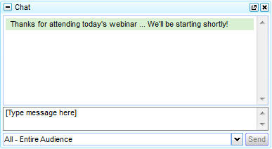
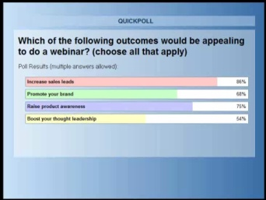



Housekeeping Tips
Links to bios and slides
Polls
An on-demand
recording of today’s webinar will be made available
How to ask
a question
… or send us a Tweet us at @directionsmag, and include #OGCwebinar
Survey
Notes:
3

Slide 4

Take advantage of all Directions Magazine has to offer
Notes:
4

Slide 5

Poll #1
Are you involved in water resource management?
Yes, directly involved
Yes, indirectly involved
No, I’m just curious about the project

Slide 6
Poll #2
Do you consider yourself a “technical IT person”?
  Yes, I’m on the developer side
  No, not really

Slide 7

OGC and Project Overview
Lew Leinenweber
CHISP-1 Initiative Manager
Open Geospatial Consortium (OGC)

Slide 8
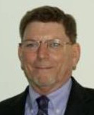
Open Geospatial Consortium
Climatology-Hydrology Information Sharing Pilot, Phase 1 (CHISP-1)
Demonstration of Capabilities
16 April 2013

Slide 9
Agenda
Welcome, Housekeeping, How To Ask a Question, Agenda Review
Introduction to Open Geospatial Consortium (OGC) and Project Overview
Acknowledge Sponsors
Technical architecture and demonstration overview for the initiative
Live Demonstration
Component details (Participants)
Achievements & Challenges
Project Resources (Participants and Sponsors)
Question & Answers

Slide 10
OGC at a Glance
A non-profit, international voluntary consensus standards organization that is leading the development of standards for geospatial and location based services.
Founded in 1994.
480+ members and growing
38 implementation standards
Hundreds of product implementations in the market
Broad user community implementation worldwide
Alliances and collaborative activities with ISO and many other SDO’s

Slide 11

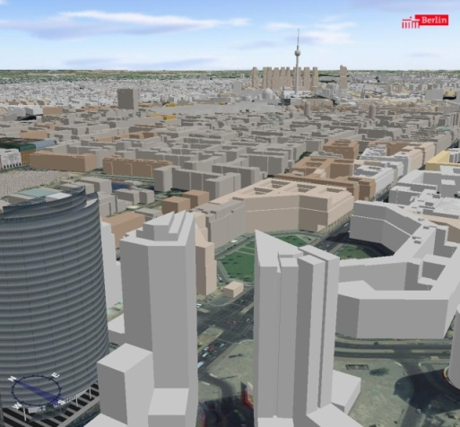
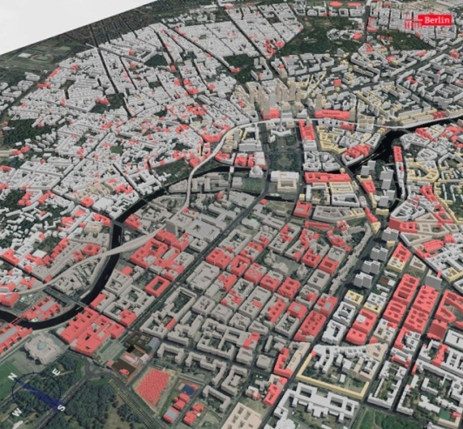
The OGC Mission
To serve as a global forum for the collaboration of developers and users of spatial data products and services, and to advance the development of international standards for geospatial interoperability.
Urban Model of Berlin based on OGC CityGML
Source: www.3d-stadtmodell-berlin.de
Notes:
11

Slide 12
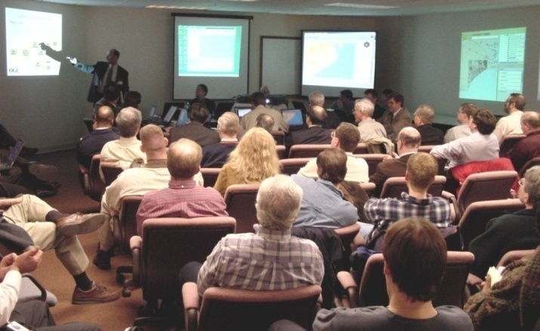
The OGC Interoperability Program (IP)
A global, collaborative, hands-on engineering, prototyping and testing designed to rapidly deliver
  Running code implementations
  Engineering Reports
  Change Requests
  Demonstration in real world scenarios
Sponsors and Participants work together.
  Sponsors provide requirements, use / business cases and funding
  Participants work with sponsors to define and/or refine standards to solve a given interoperability problem
Notes:
12

Slide 13
CHISP-1 Pilot Objectives
Create a virtual observatory system for surface and subsurface water resources observations in parts of the U.S. and Canada, building on current networks and capabilities
Link observations data to the stream network, enabling queries of conditions upstream from a given location to return all relevant gages and well locations.

Slide 14
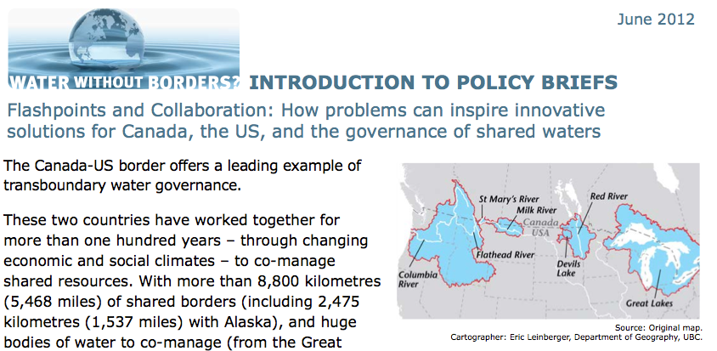
A Story of Cross Border River Basin

Slide 15
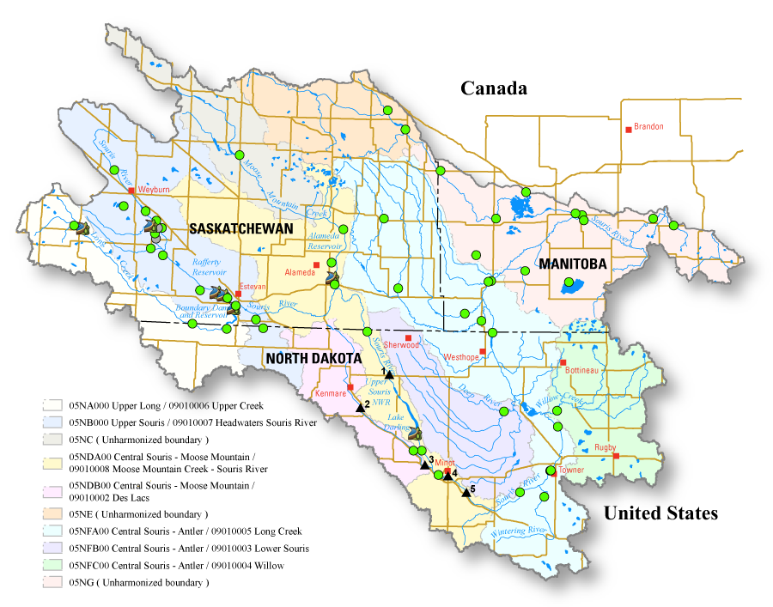
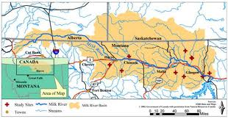
River Basins considered
Souris River Basin
Milk River Basin

Slide 16
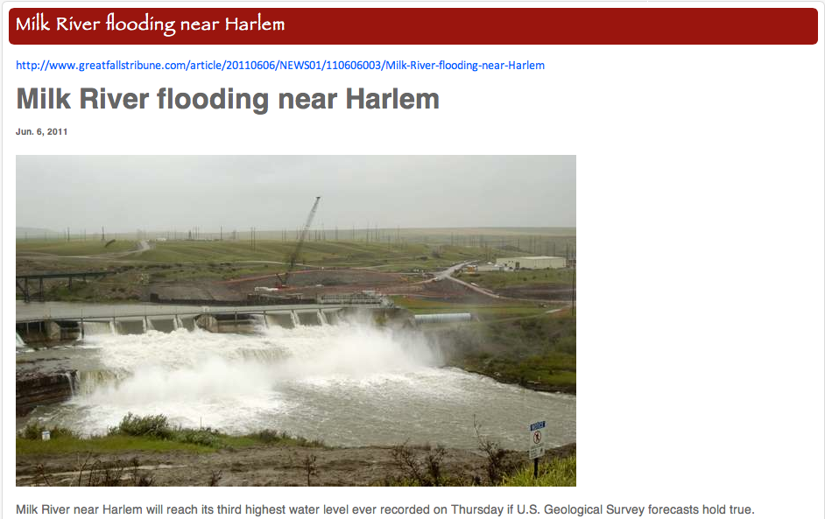
http://www.mtwytlc.org/component/content/article/99-news/2100-milk-river-flooding-near-harlem.html

Slide 17
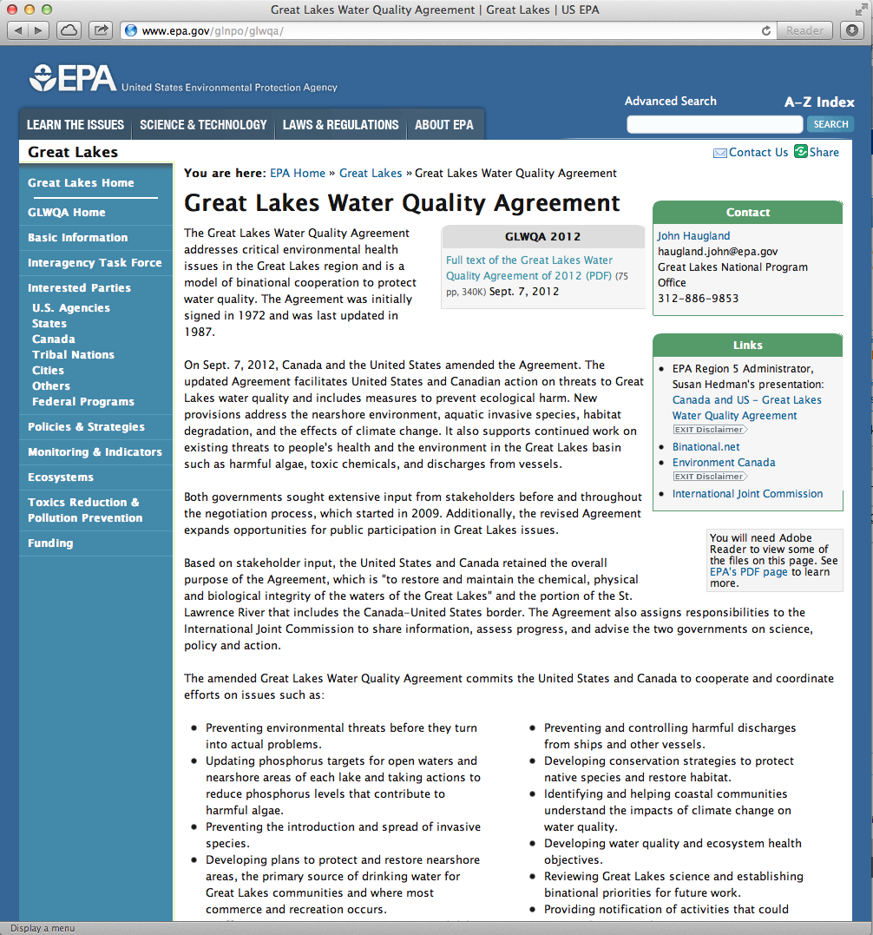
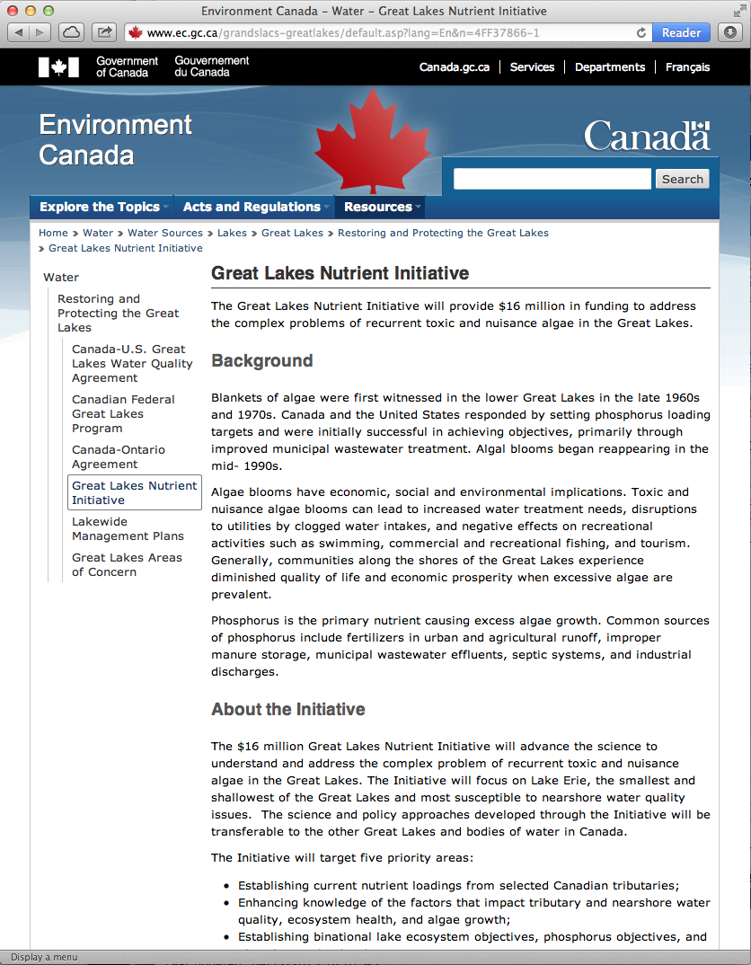
Cross-border Water Quality Initiatives and Agreement
http://www.epa.gov/glnpo/glwqa/20120907-Canada-USA_GLWQA_FINAL.pdf
Establish current nutrient loadings from selected US & Canadian tributaries

Slide 18
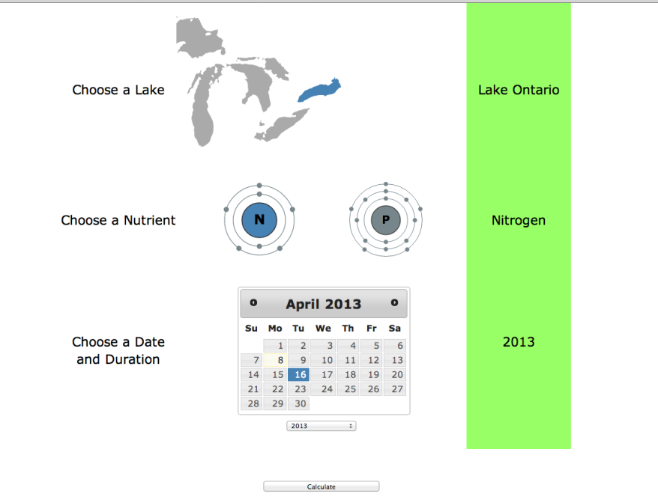
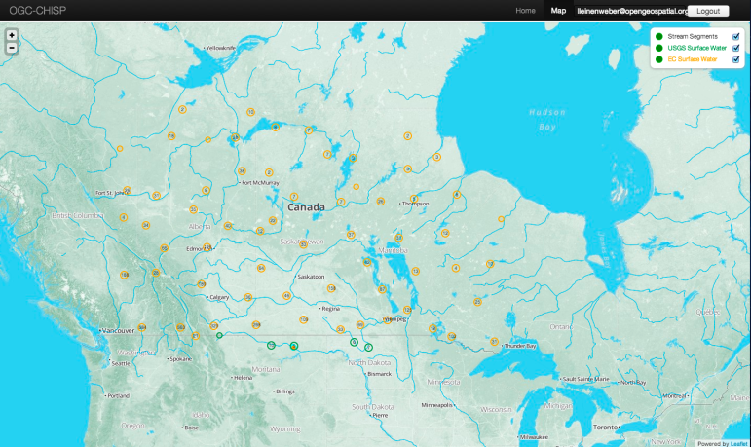


CHISP-1 Functions
Alerting system for historical and current stream flow and groundwater conditions & simulations of past flooding events.
Modeling and assessment of nutrient loads into the Great Lakes.

Slide 19



CHISP-1 Sponsors and Data Providers
Natural Resources Canada (NRCan)
GeoConnections – Project Funding $75K USD
Groundwater Geoscience Program
SOS (groundwater gauges: from Groundwater Information Network including AB Environment)
SOS (stream gauges: from EC HYDAT)
WMS (groundwater and stream gauge locations)
Mapping Information Branch – Sherbrooke
WPS (identifying upstream network from NHN/NHD network data)
Environment Canada (EC)
Historical streamflow data in mdb file
Real time streamflow data via SOAP service
Other Providers:
Multi-Agency Situational Awareness System (MASAS)
Ministry of Environment (MoE) (Provincial Water Quality Monitoring Network (PWQMN)
WFS (Stream gauges)
SOS (WaterML2 Services) (stream gauges)
WMS (Gauge stations on a map)
Water Quality Portal
Water Quality Portal
Water Quality (WQX) data

Slide 20

CHISP-1 Participant Team
Applied Science Associates
Explorus Data Solutions
Geographic Information Systems Research Center, Feng Chia University (GIS.FCU)

Slide 21
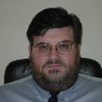
Technical Architecture and Demonstration Overview
Peter Vretanos
CHISP-1 Initiative Architect
CubeWerx

Slide 22
TECHNICAL ARCHITECTURE & DEMO OVERVIEW
Peter Vretanos (CHISP-1 Initiative Architect) (CubeWerx)

Slide 23
CHISP-1 Technical Architecture
Scenario 1: Upstream monitoring & flood event
  Components used
  wiring/interaction diagram
Scenario 2: Great Lakes nutrient load calculation
  Components used
  wiring/interaction diagram
Notes:
23

Slide 24
Components for Scenario 1
Component | Output | Provider | OGC Standard
Sensor Observation Service (Water Level, Water Flow, historic & live) | WaterML V2.0 | Environment Canada | SOS 2.0
Sensor Observation Service (Groundwater Level) | WaterML V2.0 | NRCan | SOS 2.0
Web Processing Service (Upstream geometry NHD/NHN) | WPS 1.0 | NRCan | WPS 1.0.0
Sensor Observation Service (Water Level, Water Flow) | WaterML V2.0 | USGS | SOS 2.0
Web Feature Service (Station info) | WaterML V2.0 | USGS | WFS 2.0
Web Processing Service (Upstream stations/gauges) | WPS 1.0 | ASA | WPS 1.0.0
Web-based Subscription Client |  | Explorus
Catalogue (Service metadata, Station metadata) | ISO 19115, ISO 19119, OGC Core (csw:Record) | Explorus | CSW 2.0.2, APSIO 1.0.0
Event Notification Service (Monitor stations, flood event notification) | email | GIS-FCU | WNS 0.0.9
MASAS Cap alert system | CAP message | Gov of Canada
Notes:
24

Slide 25
Scenario 1
Stream monitoring & flood event
Scenario 1 can be broken down into 3 activities
Monitoring: The system periodically monitors stream and ground water gauges and tracks their last value
Subscription: An EM analyst indicates his/her desire to be notified of an event of interest – such as a flood – by choosing a monitoring point and subscribing to all the stations upstream of that point
Notification: The system checks the monitored values from activity 1 against thresholds specified in activity 2 to determine if a flood is imminent and notification is required
Notes:
25

Slide 26
SOS
(WATER LEVEL, FLOW)
SOS
(GW LEVEL)
SOS
(WATER LEVEL, FLOW)
WFS
(Station info)
WPS
(Upstream gauges)
Monitoring
Activity
EC/NRCan
NRCAN
USGS
USGS
ASA/NRCan
CSW
Event
Notification
System
Client #1
Explorus
Harvester
Explorus
Broker
CAP
RSS
Feed
WNS
... and stores those
values as part of
the metadata
maintained in the
CSW
... which causes
the broker to read
the changed value
from the CSW
The Harvester module
periodically harvests
the last value from
gauges on the network
Whenever the
harvester reads
a value that has
changed it notifies
the broker ...
The broker can
then process this
value to determine
if a flood event
is imminent
GIS-FCU
Notes:
26

Slide 27
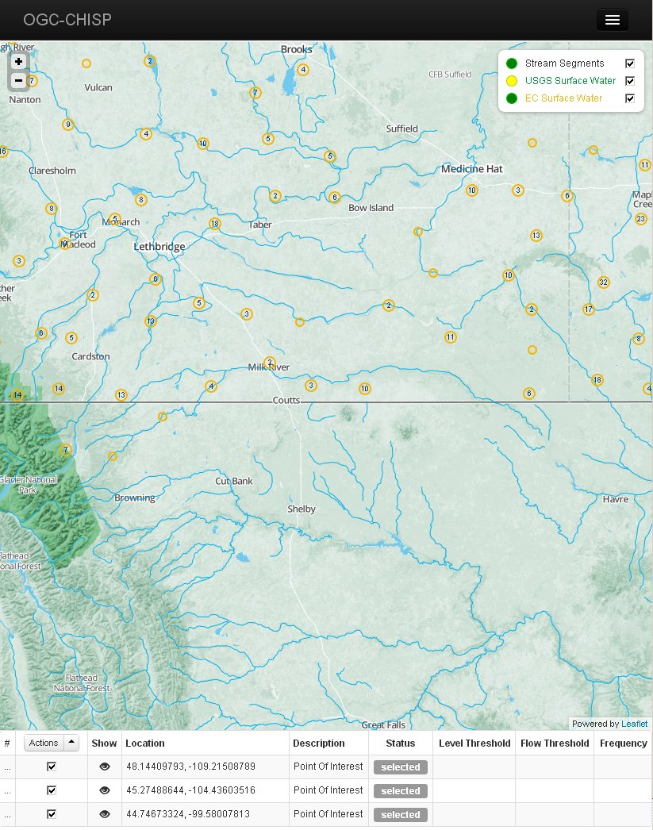
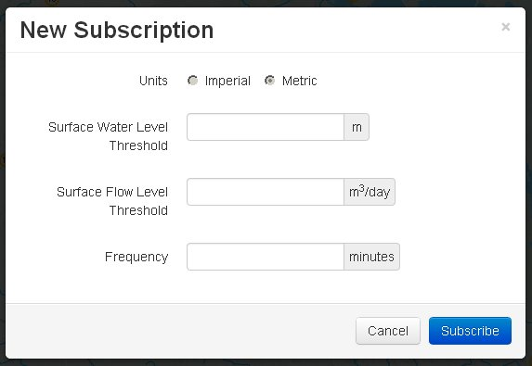
SOS
(WATER LEVEL, FLOW)
SOS
(GW LEVEL)
SOS
(WATER LEVEL, FLOW)
WFS
(Station info)
WPS
(Upstream gauges)
Subscription
Activity
EC/NRCan
NRCAN
USGS
USGS
ASA/NRCan
CSW
Event
Notification
System
Client #1
Explorus
Harvester
Explorus
Broker
CAP
RSS
Feed
WNS
... which is then
used to create a
subscription
... which causes
the broker to
get the list of
upstream stations
to monitor
... and register
the subscription
with the WNS
An EM analyst uses
web client to show
water monitoring
stations on a map
... and chooses
a station or
monitoring point
of interest
GIS-FCU
Notes:
27

Slide 28
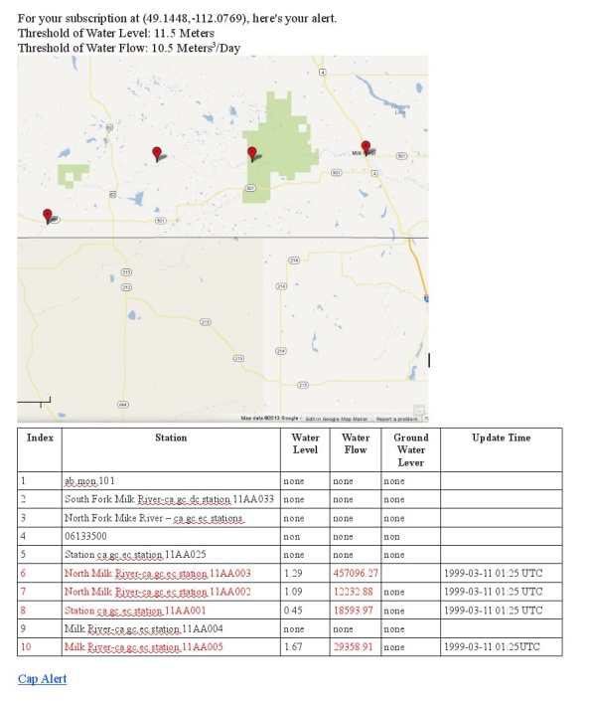
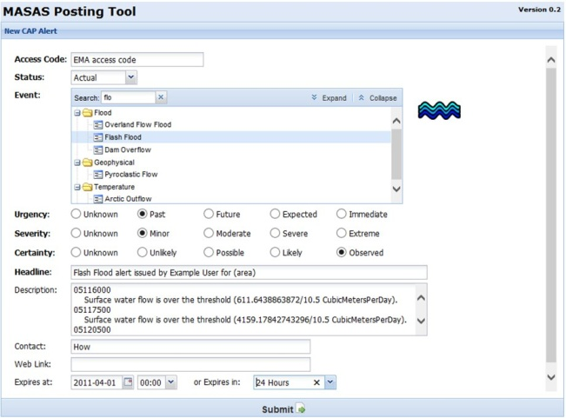
SOS
(WATER LEVEL, FLOW)
SOS
(GW LEVEL)
SOS
(WATER LEVEL, FLOW)
WFS
(Station info)
WPS
(Upstream gauges)
Notification
Activity
EC
NRCAN
USGS
USGS
ASA/NRCan
CSW
Event
Notification
System
Client #1
Explorus
!
Harvester
Explorus
Broker
Bringing up the MASAS posting tool that can be used to create and send a CAP alert
CAP
MASAS
RSS
Feed
WNS
If the value violates
a subscription
threshold the broker
creates a notification
email.
... which sends the
notification email
to the EM analyst
... and uses the
WNS to do the
notification
Among other things,
the notification
includes a link to
invoke a CAP alert
... which the EM
analyst can click
When notified by
the Harvester the
broker reads the
last value from
the CSW
GIS-FCU
Notes:
28

Slide 29
Components for Scenario 2
Component | Output | Provider | OGC Standard
Sensor Observation Service (Water Level, Water Flow, historic & live) | WaterML V2.0 | Environment Canada | SOS 2.0
Sensor Observation Service (Water Level, Water Flow) | WaterML V2.0 | USGS | SOS 2.0
Sensor Observation Service (Integrates US and CAN Water Quality servers) | IOOS SWE XML | ASA | SOS 2.0
SPARQL server (Analyte equivalents US, Can) | RDF | NRCAN
Web Processing Service (Nutrient load calculation) | WPS 1.0 | ASA | WPS 1.0.0
Web-based NLCS Client |  | ASA
Catalogue (Tributaries, stream & WQ gauges) |  | ASA
Notes:
29

Slide 30
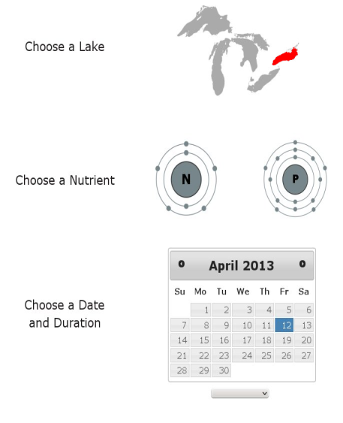
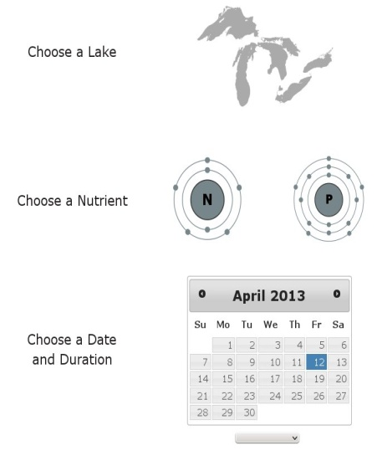
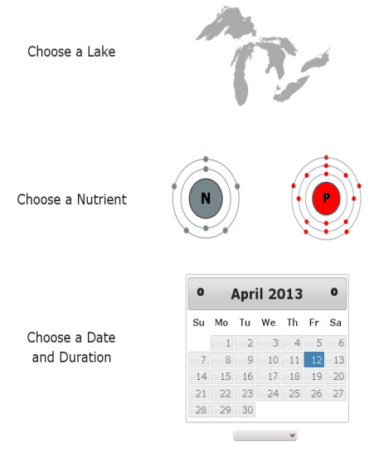
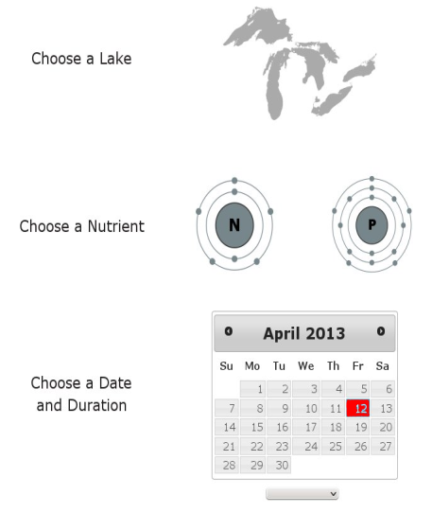
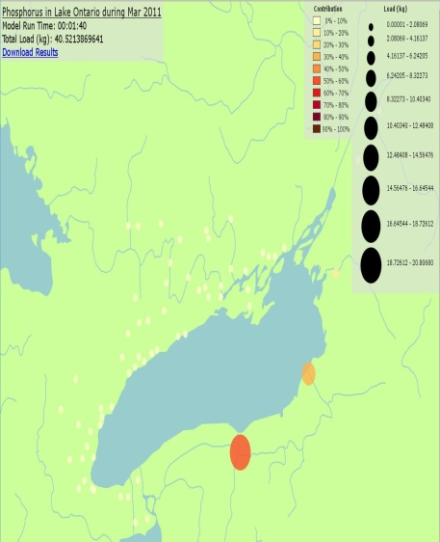
SOS
(WATER LEVEL, FLOW)
SOS
(WATER LEVEL, FLOW)
SOS
(WATER QUALITY)
CDN WQ Server
EC/NRCan
USGS
ASA
US WQ Server
WPS
(NLCS)
SPARQL Server
Client #2
ASA
NRCAN
ASA
Catalogue
... which queries the catalog
for tributaries on the
lake of interest that have
both a stream gauge and
water quality samples available
for the nutrient of interest
For the stations returned
by the catalogue query,
the NLCS makes requests
to the water quality and
stream flow SOS services
It interpolates the water quality
and stream flow measurements
for the period specified
by the request
Calculates nutrient flux from
the interpolated measurements
and numerically integrates the
results to determine the total
load over the period of interest
for each tributary
It sums all of the tributaries'
contributions for the total load
on the lake (converting
units between standard
and SI where appropriate)
... and presents the results to
the WQA
A WQA initiates the nutrient load
calculation web client and
provides these inputs:
A WQA initiates the nutrient load
calculation web client and
provides these inputs:
- a Great Lake of interest
A WQA initiates the nutrient load
calculation web client and
provides these inputs:
- a Great Lake of interest
- the name of an analyte
A WQA initiates the nutrient load
calculation web client and
provides these inputs:
- a Great Lake of interest
- the name of an analyte
- a time period of interest
The web client invokes the
nutrient load calculation
WPS to run the model.
ASA
Notes:
30

Slide 31
LIVE DEMONSTRATION AND COMPONENT DETAILS
Peter Vretanos (CHISP-1 Initiative Architect) (CubeWerx)
Alex Joseph (Explorus Data Solutions)
Chen-Yu Hao (“How”) (Geographic Information Systems Research Center, Feng Chia University (GIS.FCU)
Alex Crosby (Applied Science Associates)

Slide 32


Demo: Upstream Monitoring and Flood Event
Alex Joseph
Executive Director
Explorus Data Solutions
ChenYu Hao (How)
Project Manager
FengChia University

Slide 33


open data and app solutions
focused on water and environment
http://www.explorus.org
We help government, industry, and NGOs
reduce time, cost and resources
to access and utilize water and environmental data.

Slide 34
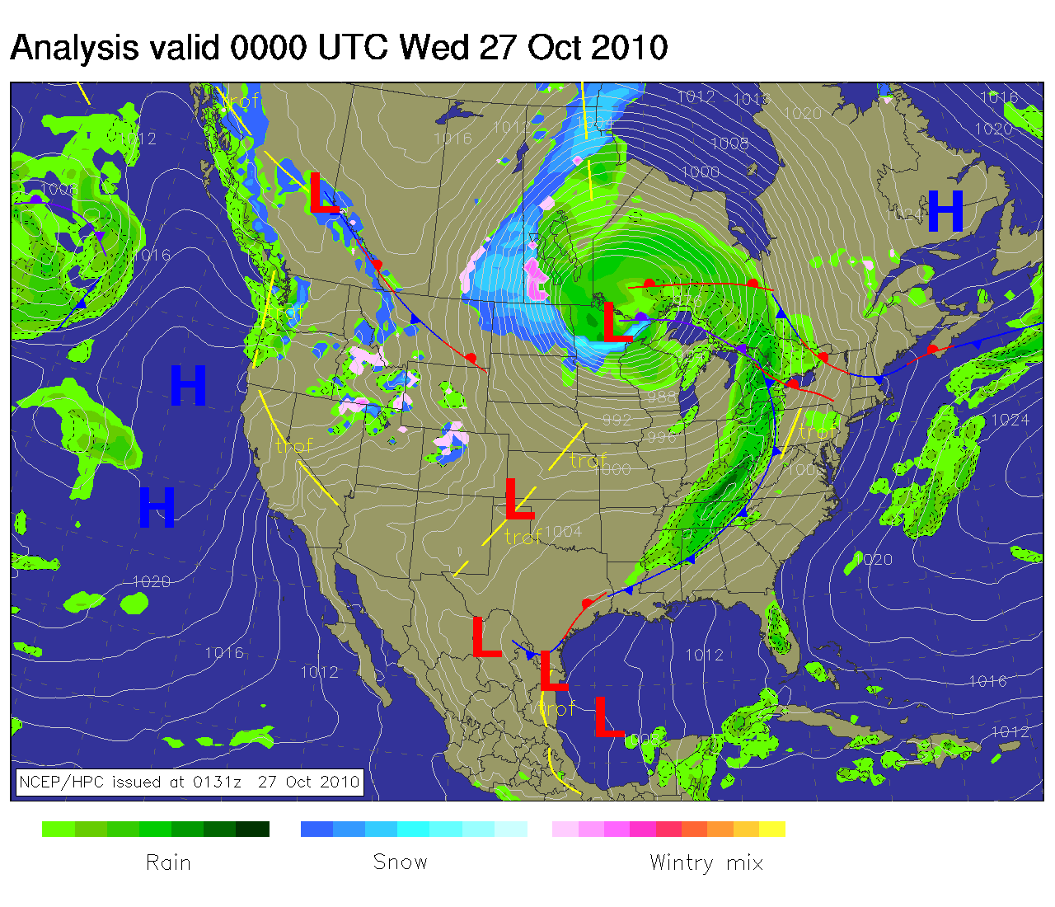

Slide 35
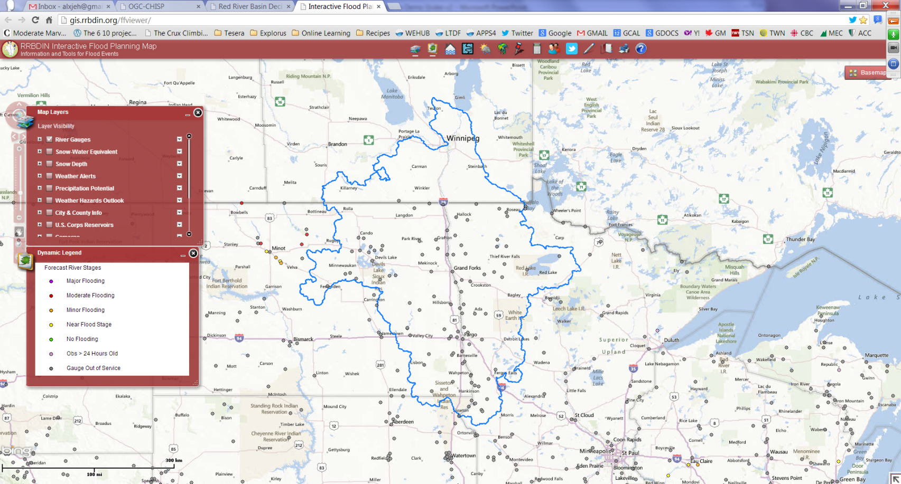
  In the flood of 2011, Manitoba suffered $1B flood damages,
  North Dakota and Saskatchewan +$1B

Slide 36
Before OGC CHISP-1 | After OGC CHISP-1
Local, phone, fax, email | Web-based
Single station Individual networks Individual jurisdictions | Multiple stations Multiple networks Multiple jurisdictions
Subscribe to individual gauges | All upstream alerts

Slide 37
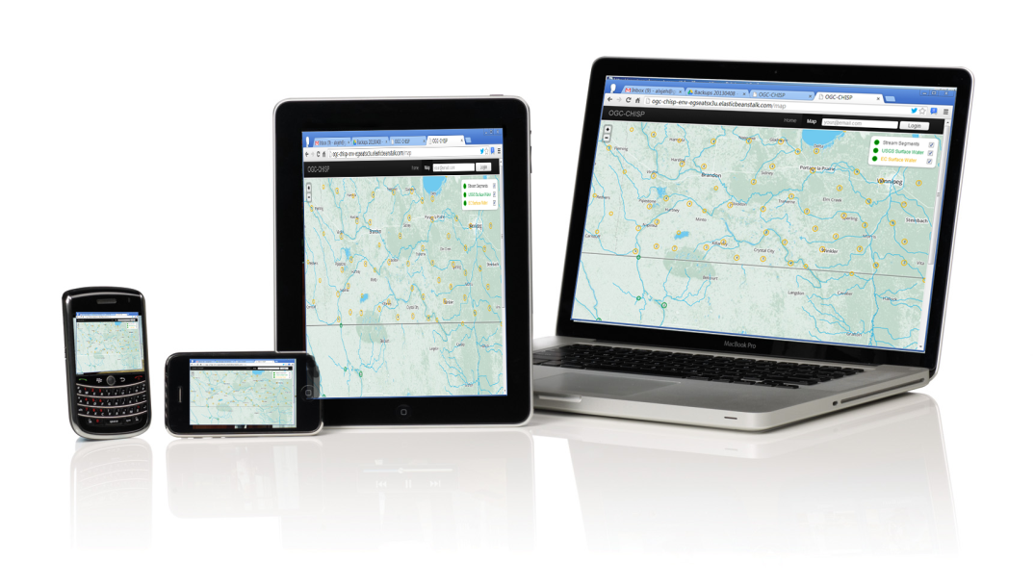
Achievements
First time an EM Analyst (or anyone) can view trans-boundary upstream hydrometric (+ groundwater) data via web in real-time...
...monitor all available upstream stations and be alerted in case of flood and/or drought.

Slide 38
Challenges
This is the first iteration of a upstream monitoring/flood alert solution...
  What variables to use when setting alert?
  Why subscription approval so slow?
  Why selecting stream segments difficult?
  ...next iterations of the solution would fix/add these features.

Slide 39

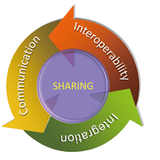

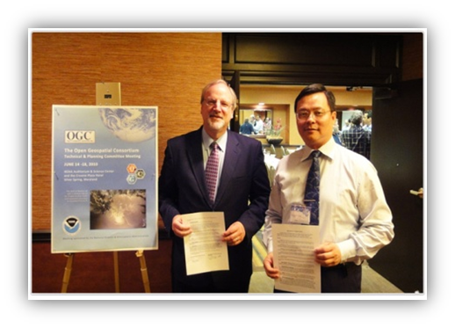
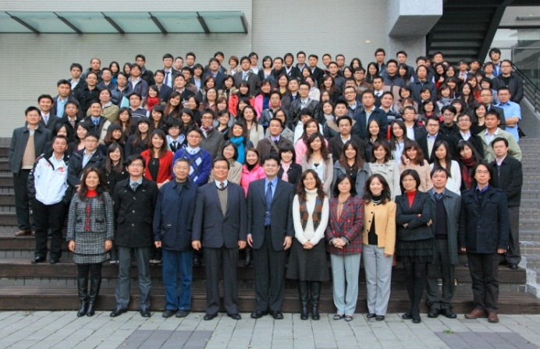
GIS.FCU
Founded in August 1995
Business Philosophy ➔
I²C+S (Interoperability, Integration,
Communication, and Sharing)
Vision ➔ A Pioneer of GIS Applications
International Cooperation
Participate OGC TC/PC meetings
Participate GEOSS Plan
Participate multinational large-scale projects
Int’l academic exchange
I²C+S
OGC Compliance
Testing Center

Slide 40
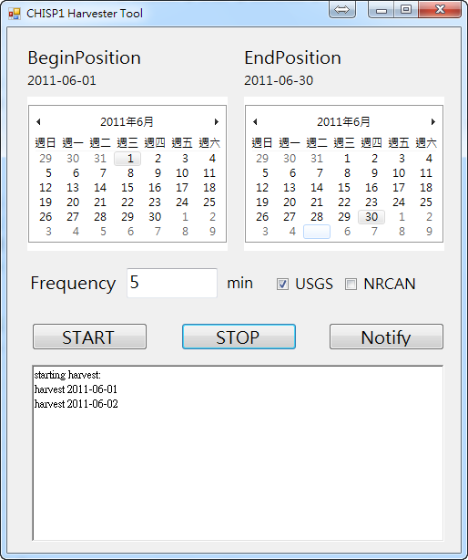
Scenario 1 back end service demo
Harvester
Event Notification
CAP alert

Slide 41
Components Details of GIS.FCU
SOS 2.0 GetDataAvalibility
Harvester
  Get last value from all SOS
  Lase value changed or not
Event Notification
  Broker
  WNS(Email, RSS, ATOM)
  CAP Alert

Slide 42
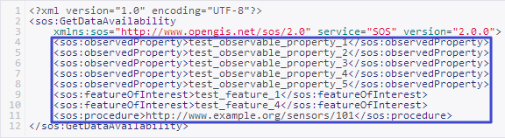
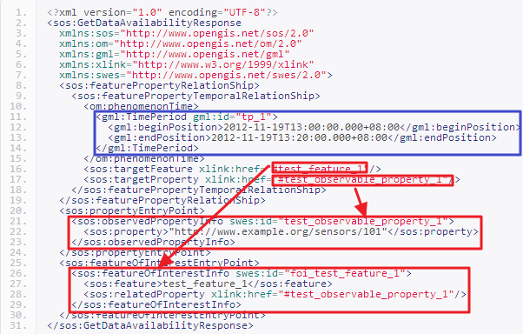
GetDataAvailability( Improved the 52North SOS)
GDA Request
  ObservedProperty
  FeatureOfInterest
  Procedure
GDA Response
  PhenomenonTime
  ObservedPropertyInfo
  FeatureOfInterestInfo

Slide 43

Wiring Diagram-Harvesting Method
CSW
(Explorus)
SOS
(NRCan)
(USGS)
Get SOS url
Insert/update last value
Get Last value
Harvester
GIS.FCU
Notify broker get last value from CSW
Broker
(GIS.FCU)
http://59.125.87.213/Harvester/Default.aspx

Slide 44



Flood Notification Service-Subscribe process
Subscription Clientweb
Explorus.Inc
req
Emergency Analysts
Email, ATOM, RSS
res
req
Notification Broker
GIS.FCU
req
req
UpstreamWPS
ASA
WNS
GIS.FCU

Slide 45

Flood Notification Service- determine process
req
Sensor Observation service
Sponsors(NRCan and USGS)
res
Harvester
GIS.FCU
Emergency Analysis
Email, ATOM, RSS, CAP Alert
notify
value
req
res
alert
res
message
req
Notification Broker
GIS.FCU
Catalogue Service
Explorus.Inc
WNS
GIS.FCU

Slide 46
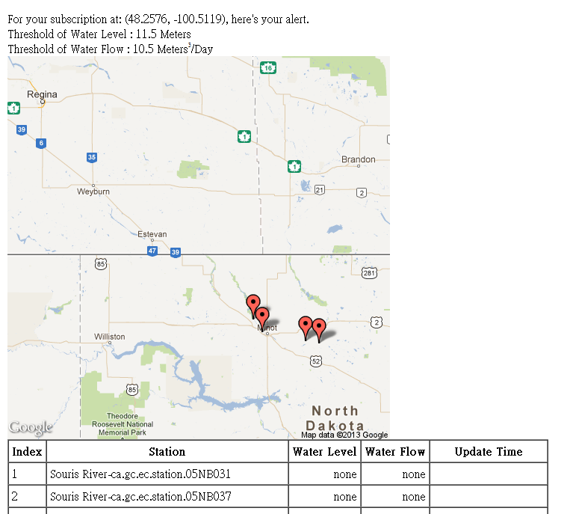
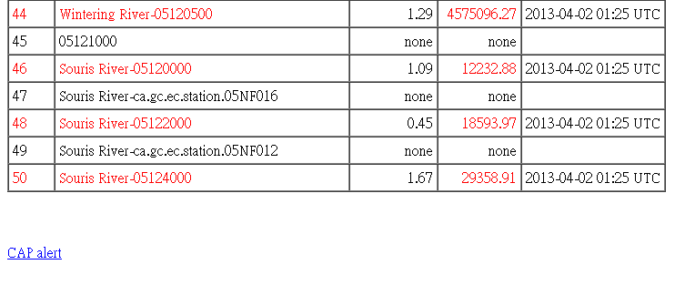
Event Notification
Subscription Info.
  Point of Interest
  thresholds
Map
  Upstream extend
  alert stations
Station list
  All upstream stations
  Measurements
  Update time

Slide 47
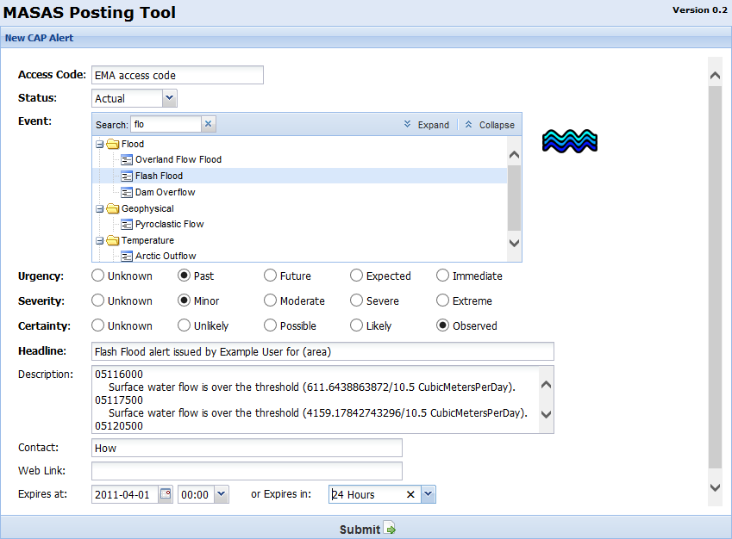
CAP Alert
An interface for OASIS Common Alerting Protocol

Slide 48
Achievements and Challenges
Achievement
  Implemented SOS GDA and will feedback to 52North Code base
  Get Obs from various SOS based on OGC standards
  OGC WNS for subscribe and notification
  trans information from WNS to MASAS system
  a Broker that can integrate with SOS, WNS, WPS, CAP and CSW
Challenges
  Current SOS profile not compile with OGC spec completely.
  Faced on the problem of services performance
  Be a role as broker, have deal with all changes and service down problems when this pilot executed.(exception process)

Slide 49

Demo: Great Lakes nutrient load calculation
Alexander Crosby
Ocean Engineer
ASA
Notes:
Thanks, Alex and How! And now Alex Crosby will be joining us. He is an engineer and project manager at RPS ASA., where he’s involved in skill assessment and validation, and worked on model and observation data interoperability and management.
Alex, good to have you with us today…

Slide 50

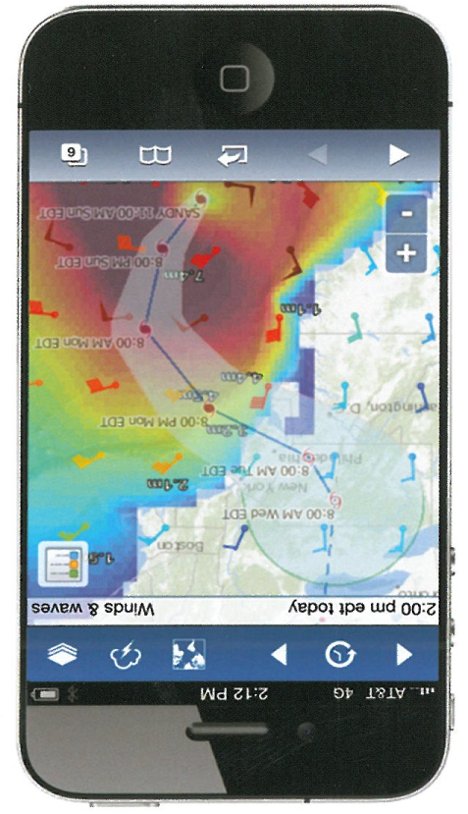
RPS ASA
Environmental consultancy and planning
Coastal and ocean science and engineering
Coastal and marine geoscience
Integrated real-time monitoring systems
Numerical modeling of physical, chemical and biological processes
Data management

Slide 51
CHISP Pilot Components
Scenario #1
  WPS to identify gauges IDs on upstream river network
Scenario #2
  WPS to calculate cross-border nutrient loads in Great Lake/tributaries
  SOS service for cross-border water quality data
  Nutrient model web client

Slide 52
Achievements
Single SOS service for international water quality sample data
Integration of international data services for stream flow and water quality in order to run a web based nutrient load model
System to identify upstream stream gauges regardless of relation to US/CAN border
Challenges
Robustness and speed of remote services
Heterogeneity of data and metadata from different sources
Differences between development and production environments and problems with bugs in open source libraries

Slide 53
Achievements and challenges
Lew Leinenweber (OGC Initiative Manager)
Peter Vretanos (Initiative Architect) (CubeWerx)

Slide 54
Functional Achievements

Slide 55
Technical Achievements
Map-based subscription web client
CSW (Python Implementation)
SOS GetDataAvailability
Notification broker
Harvester method
CAP alert client for Multi-Agency Situational Awareness System (MASAS)

Slide 56
Technical Achievements
Web-based NLCS client
SOS facade on existing non-OGC sources of water quality information
Indexing service
Nutrient load calculation service (WPS)
Upstream gauges/wells (WPS)
SPARQL server for mediation of analyte vocabularies

Slide 57
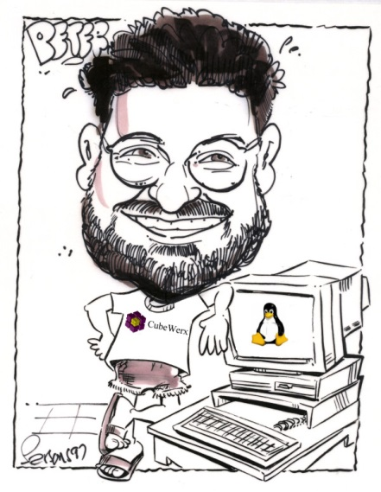
Technical Challenges
Service performance and stability
Large networks of sensors are not sufficiently supported in SOS standard
Catalogue issues
SPARQL server
Data and software issues implementing NLC model
Harvester module issues
GDA extension for SOS

Slide 58
CHISP-1 PROJECT RESOURCES:
CLIENTS AND SERVERS
Peter Vretanos

Slide 59
CHISP-1 Project Resources
Participant Clients and Servers
Clients
  Map-based subscription web client (Explorus)
  Web-based NLCS client (ASA)
Servers
  Water quality SOS (ASA)
  NLCS WPS (ASA)
  Upstream gauges/wells (ASA)
  Catalogue Service Web – pycsw (EC / Explorus)
  SOS with GDA extensions (GIS-FCU)
  CAP Alert client (GIS-FCU)
  Notification broker (GIS-FCU)
  Harvester method (GIS-FCU)

Slide 60
CHISP-1 Project Resources
Sponsor Servers
Servers
  Groundwater SOS (NRCan)
  Groundwater wells WFS (NRCan)
  SPARQL endpoint (NRCan)
  Upstream indexing service (NRCan)
  GIN SOS mediator (EC)
  Stream gauges (USGS)
    WFS (returning WML2)
    SOS (via GetDataAvailability request)
  Stream flow SOS’s (USGS)
    SOS (unit values)
    SOS (daily values)

Slide 61
Speakers’ contact information
Lew Leinenweber - lleinenweber@opengeospatial.org
Peter Vretanos - pvretano@cubewerx.com
Alex Joseph - alex.joseph@explorus.org
ChenYu Hao (How) - how@gis.tw
Alexander Crosby - acrosby@asascience.com

Slide 62
One more poll…
Did you watch this webinar by yourself, or with others?
Just me…
One other person
2-3 more people
4 or more people

Slide 63
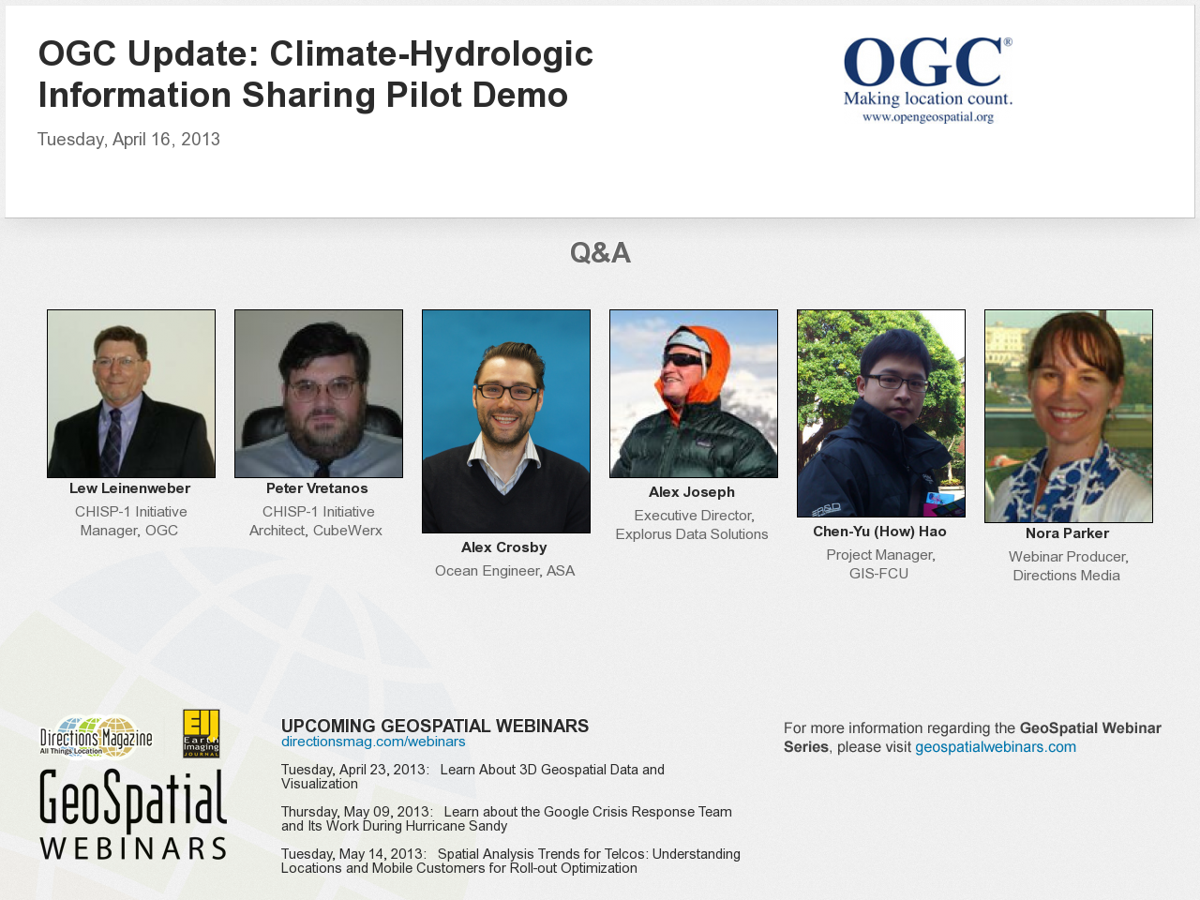
Notes:
63

